Slide 1

Newspapers and the Austrian Post
Choosing, ordering, posting, taxing, receiving…
Reimagined from the presentation by Andy Taylor FRPSL
Notes:
Hello! I’m Andy Taylor.
Welcome to this guided overview of the tax and postal systems for newspapers in Austria between 1789 and 1922.
Liebe Kolleginnen und Kollegen! Herzlich willkommen zu dem Vortrag! Das Thema heute ist die Entwicklung der Zeitungsstempel und der Zeitungs-Stempelmarken, in der Kaiserlich Königlich Monarchie und danach.
I’ve tried to select the key topics. The details are in the display. I’ve treated everything in chronological order in this presentation and in the display. I found it necessary – as well as interesting – to delve into the various laws, rules, regulations, instructions etc. that controlled everything.
I do of course send my minions to scour the recycling bins of central Europe, so the condition of the exhibits is not always what you'd hope for. However, you may notice on much of the Czech material pairs of holes about 12mm apart. The previous owner had stapled the items to his backing sheets.

Slide 2
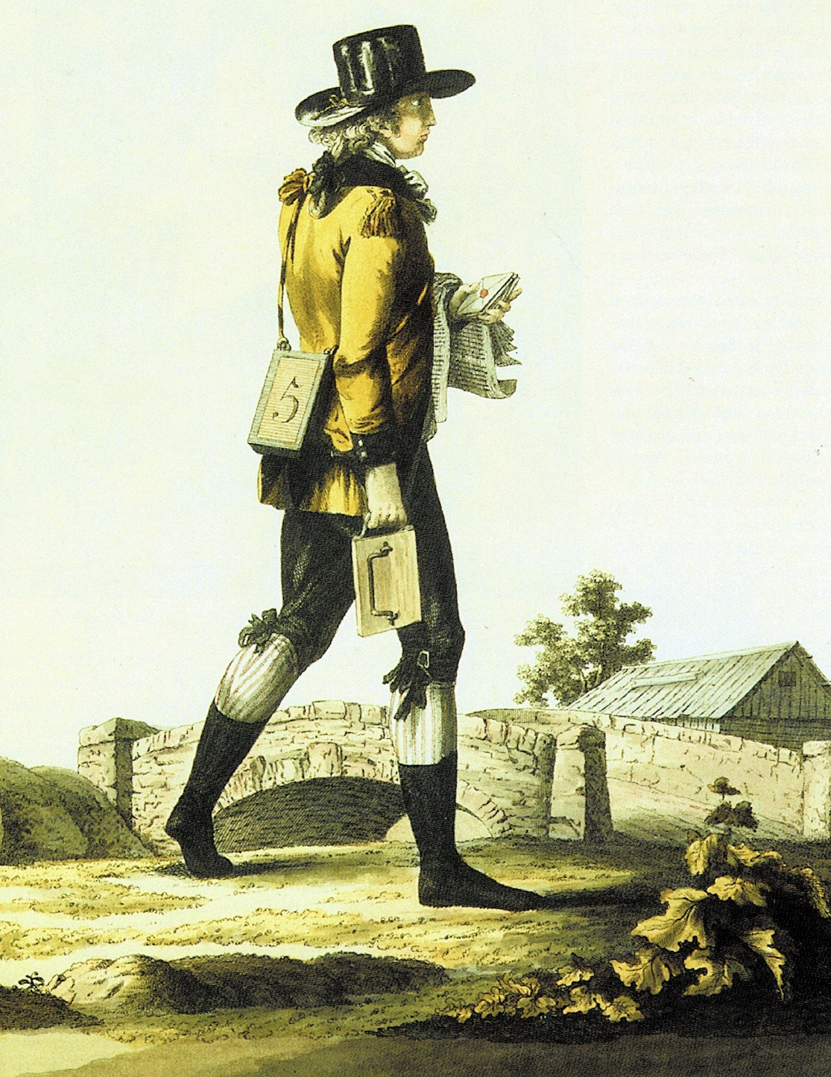
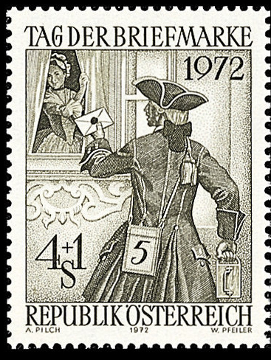
The Vision:
The rural letter-collector
and
the
city
postman.
Notes:
Click to move on.
Contrasts … the vision

Slide 3
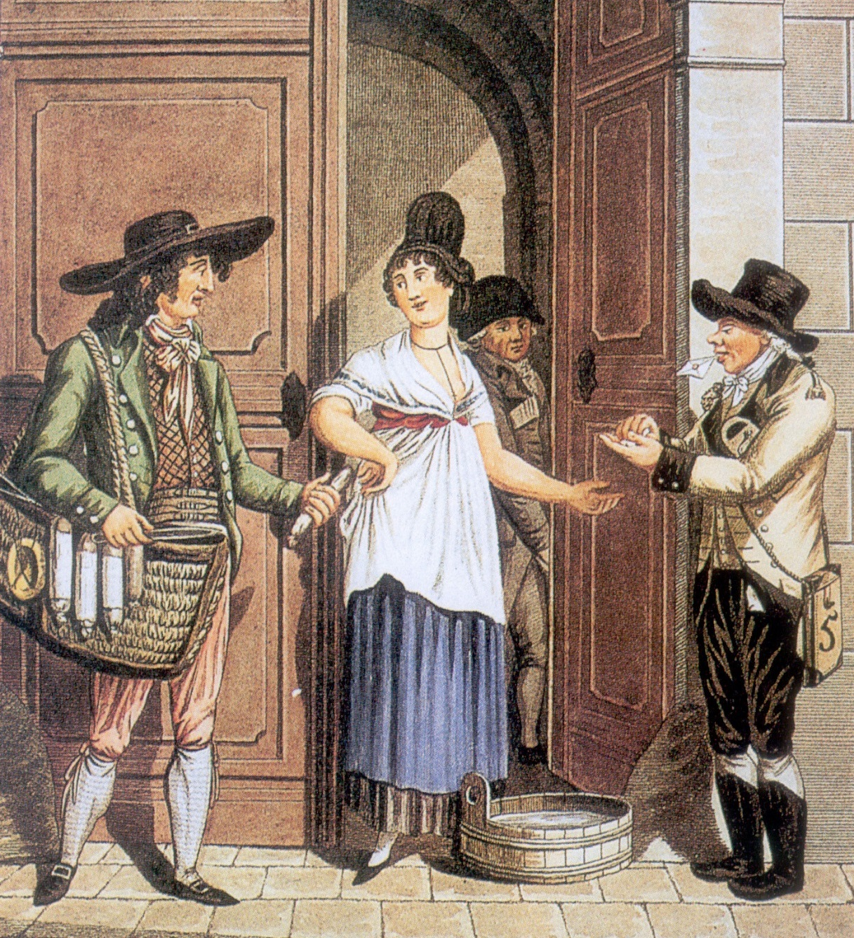
The reality!
Notes:
Click to move on.
Contrasts – the reality

Slide 4
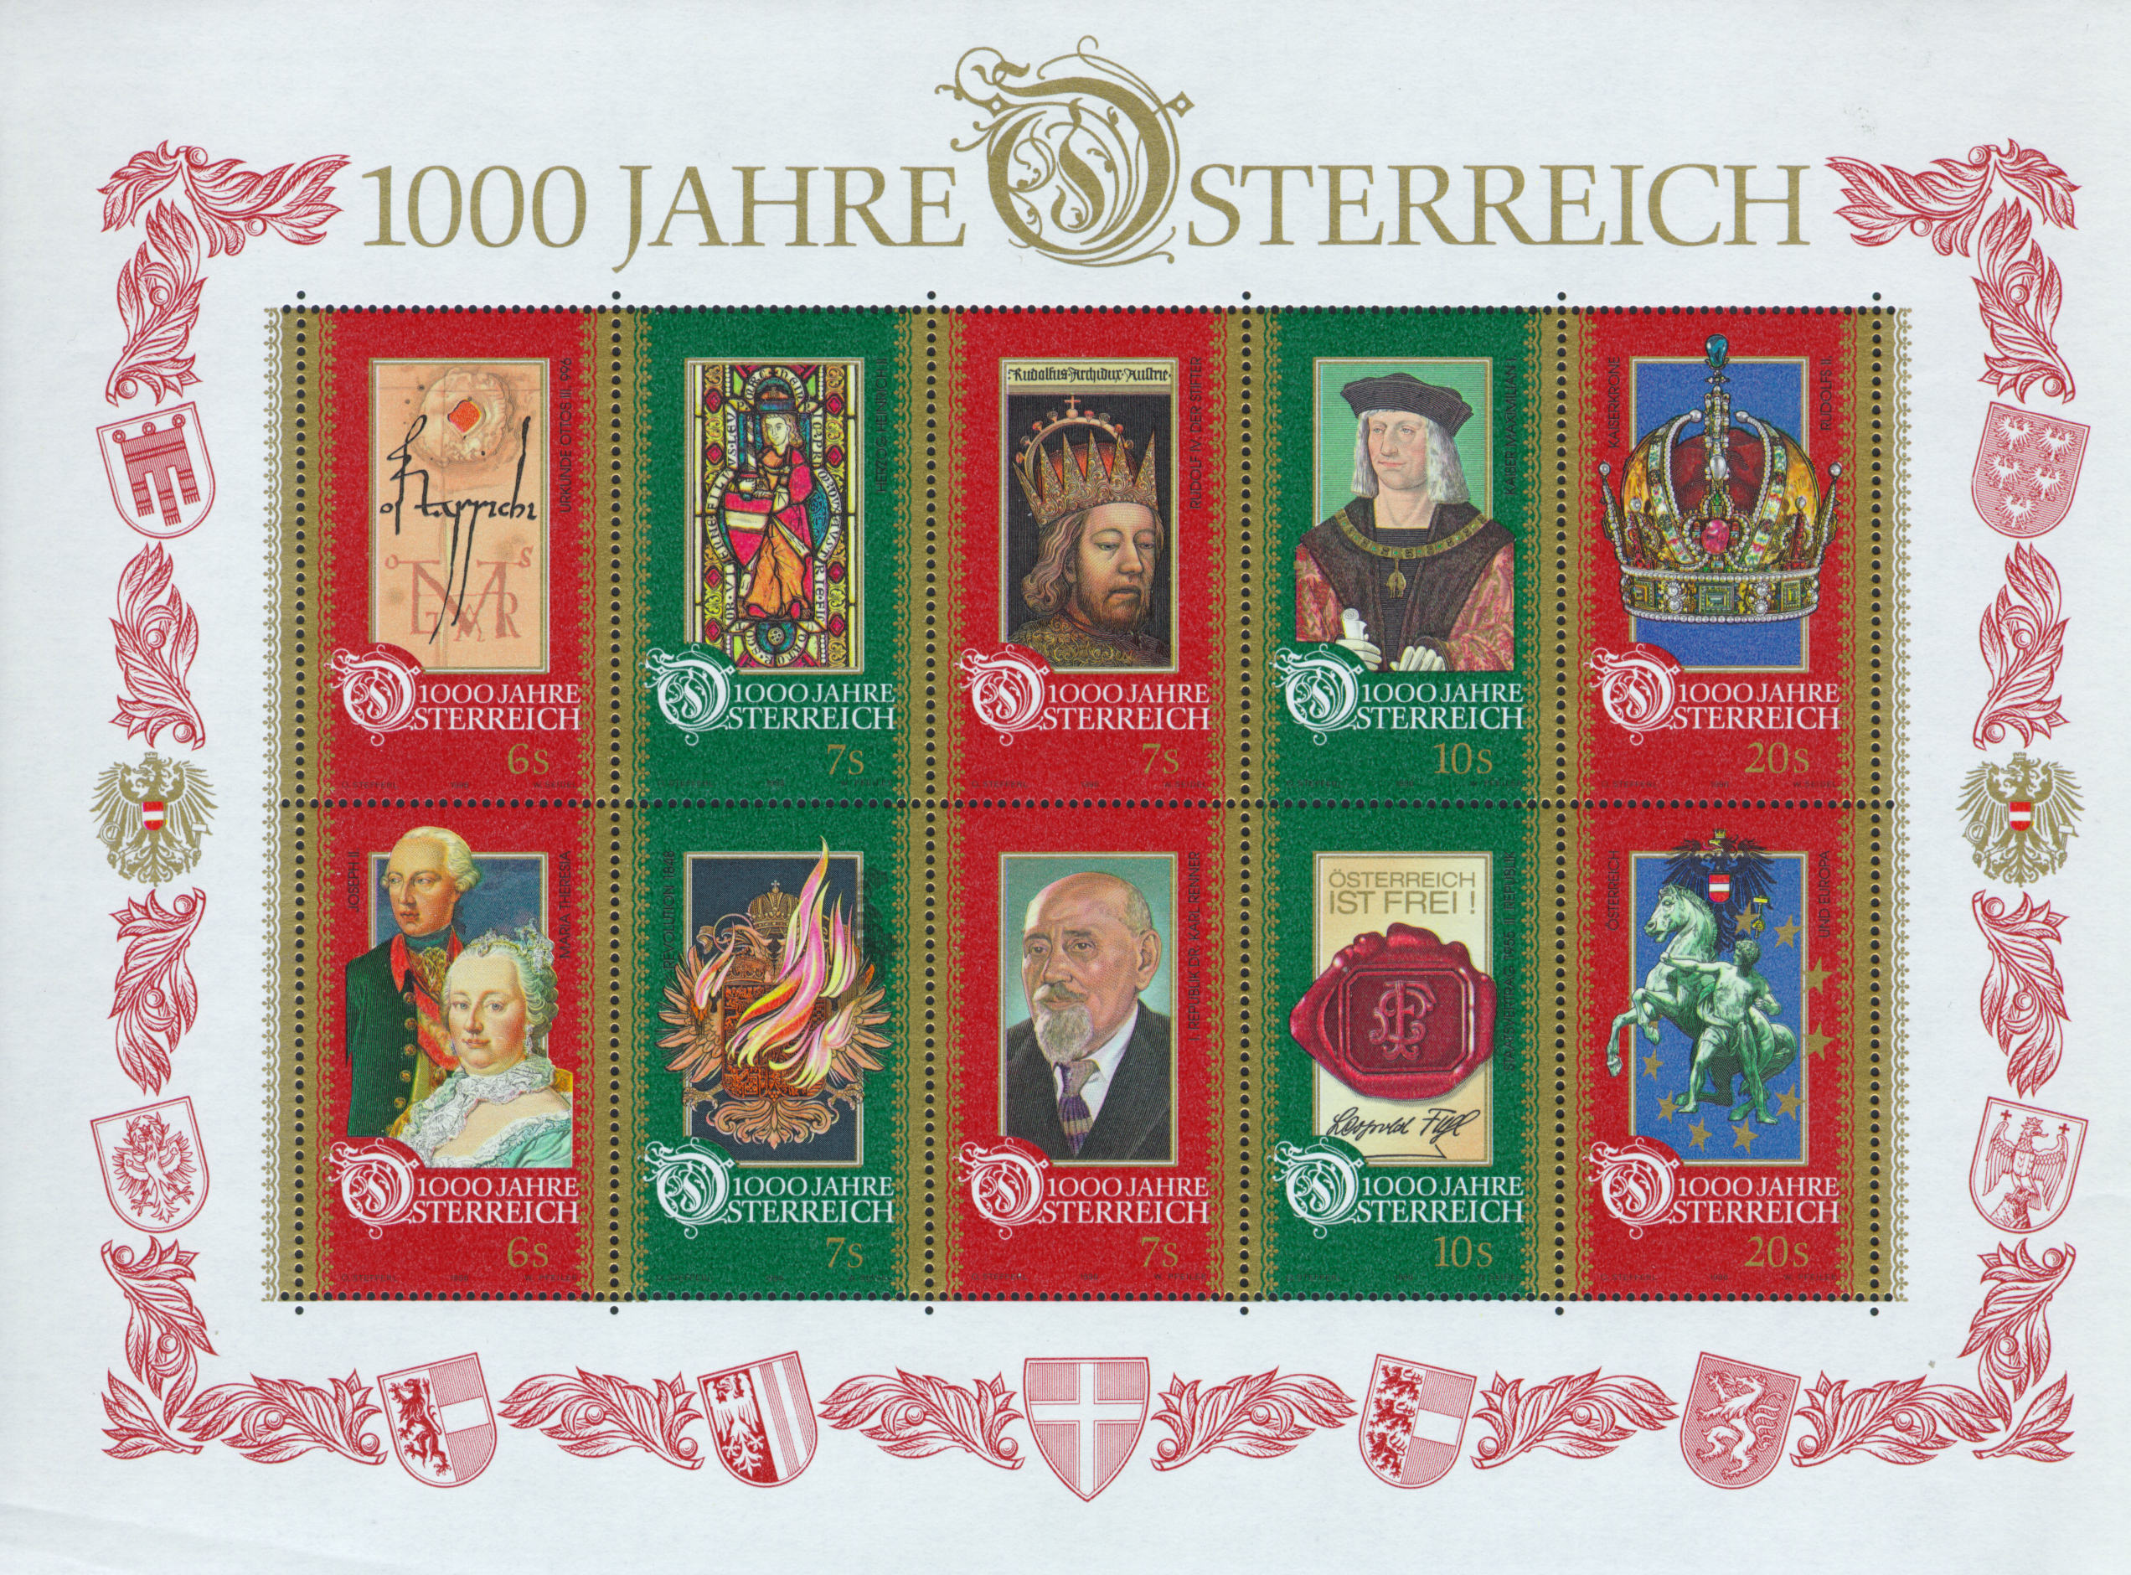
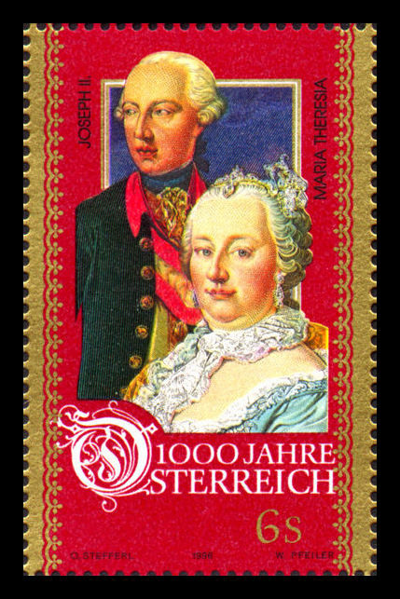
1996 block
issue for Austria’s
millennium
Notes:
Manual click
I find that Austrian philately and Austrian history are inextricably intertwined – you can’t make sense of one without the other.
This is the 1996 block issued to mark Austria’s millennium. At bottom left are Holy Roman Empress Maria Theresia and her son Holy Roman Emperor Joseph II. He was Holy Roman Emperor because it couldn’t be a woman. However, she very much ruled the Austrian roost – he was in office but not in power.
More history. Until 1804, there was no Austrian Empire. Austria was an agglomeration of independent states with the same person as their ruler. The ruler of Lower Austria (which included Vienna) was also the Holy Roman Emperor, to whom the states owed allegiance. In addition, he was King of Bohemia and of Hungary; Archduke of Austria; Duke of Burgundy, of Carinthia, and of Styria; Margrave of Moravia; Count of Bregenz, Lord of the Windisch March, etc etc. Oh, and King of Jerusalem in his spare time.
In 1804 the then Kaiser Franz II anticipated – correctly - that Napoleon would abolish the Holy Roman Empire. Acting as Holy Roman Emperor, Kaiser Franz promoted Austria to an empire. He then appointed himself as Kaiser Franz I of Austria. The Viennese promptly nicknamed him Der Doppelkaiser.

Slide 5
Kaiserin Maria Theresia
and her son
Kaiser Joseph II.
She died in 1780.
Notes:
(It zooms out to this) manual click to next
Back in 1780, the Austro-Hungarian Empire included nearly all of Central Europe. There were eleven major groups scattered across the empire: Croatian, Czech, German, Hungarian, Italian, Polish, Romanian, Serb, Slovak, Slovene, and Ukrainian. Materials were expensive; labour was cheap; society was feudal; initiative was discouraged. You may have heard of Laurenz Koshier, arguably the inventor of the adhesive stamp. He was given a disciplinary transfer to Laibach, as far away from Vienna as possible, for making proposals for change above his pay grade!
Maria Theresia died on 29 November 1780, and her son Kaiser Josef II hastened to introduce all manner of reforms which she had forbidden. He believed that if only people would behave precisely as he told them, he could reorganise and improve every aspect of everybody else’s life. We all know people like that! He enthusiastically began to convert his subjects to his ways of thinking. And of course appropriate instructions were needed; and the archives are on line…

Slide 6
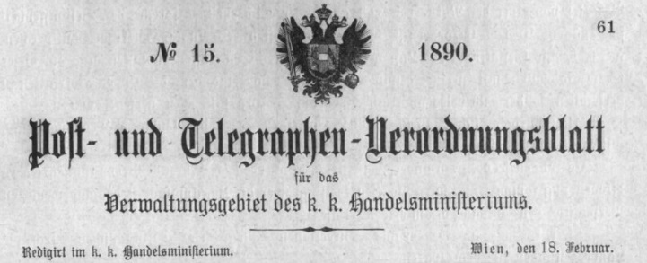
This is the Austro-Hungarian Empire.
So, everything is forbidden
Unless it is permitted;
In which case there will be
An Instruction on how to do it.
Notes:
Autoruns

Slide 7
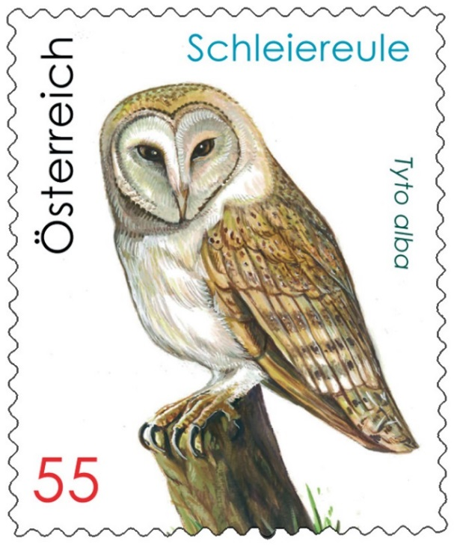

This is the Austro-Hungarian Empire.
So, everything is forbidden.
Unless it is permitted;
In which case there will be
An Instruction on how to do it.
On February 6, 1890, following agreement with the Royal Hungarian Ministry of Commerce and the Imperial German Post Office, a formal instruction was issued on how to pack a live owl to send by Parcel Post…
Notes:
Manual click for next
No I don’t know why either. See frame 52!

Slide 8
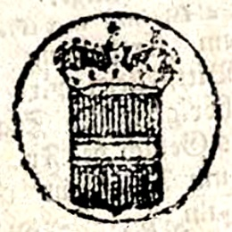
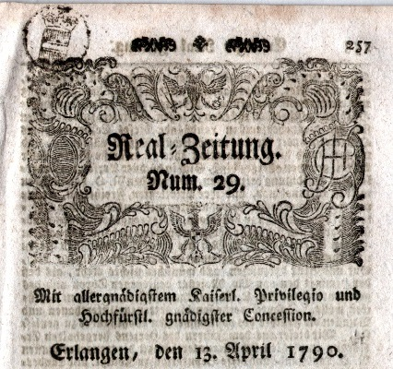
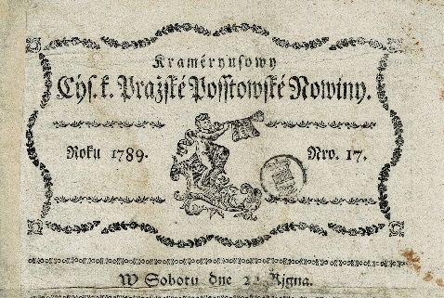
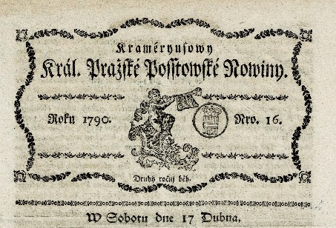
On 6 May 1789 Emperor Josef issued an Imperial Decree stating that newspapers and news-sheets would from 1 July 1789 be liable to a tax.
22 December 1789 | 17 April 1790 | 13 April 1790
Notes:
Click for next
Emperor Josef decided to finance his reforms by imposing a tax on all newspapers and pamphlets, whether published in Austria or imported from abroad; the official justification was “to raise funds for education”. Wurth makes the intriguing suggestion that the true purpose of this tax was to make newspapers more expensive, hence less copies would be sold, which would curb the spread of Revolutionary French ideas!
On 6 May 1789 Emperor Josef issued an Imperial Decree stating that newspapers and news-sheets would from 1 July 1789 be liable to a tax of ½ kreuzer Conventions Münze per Bogen (= newsprint sheet). The payment was to be indicated by “the same Signet for all, with the Austrian Arms but no indication of value or currency”. Payment of the tax was until 1853 shown by an impressed marking which he and I call a “signet”. You may wonder how big this Bogen is…

Slide 9
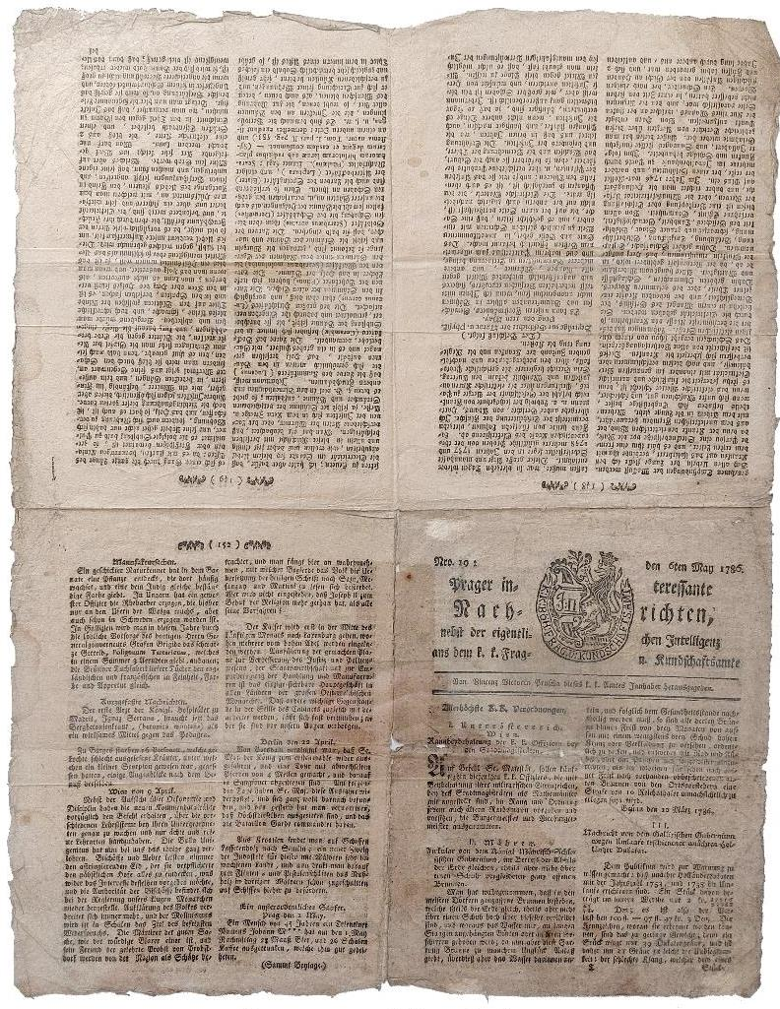
A Bogen
was
474mm x 369mm
How big is this?

Slide 10
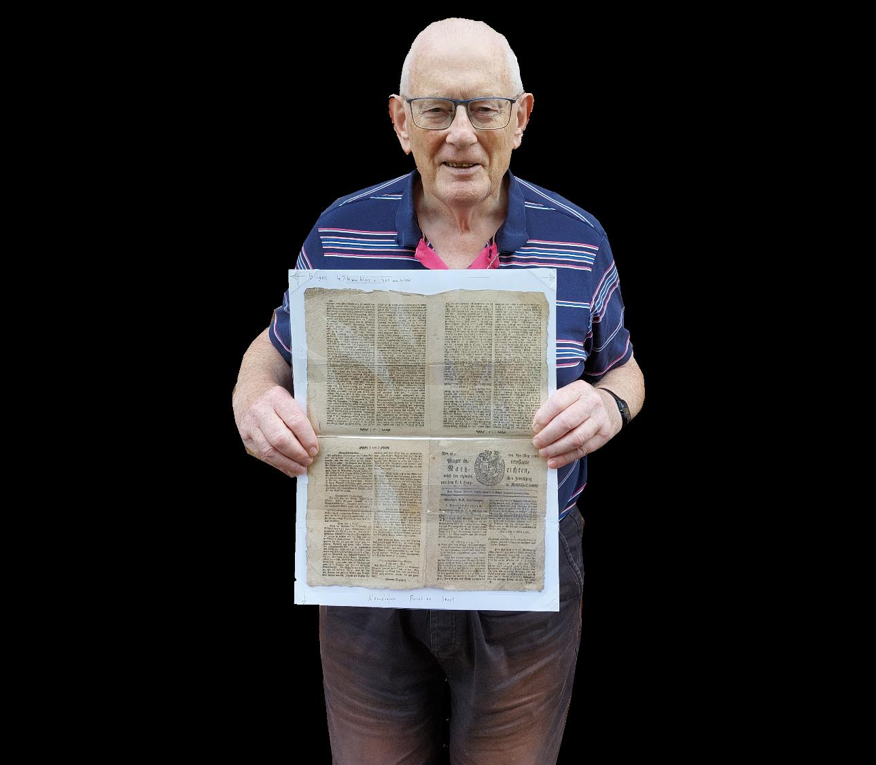

This big!
Notes:
Self-runs.
This big!

Slide 11
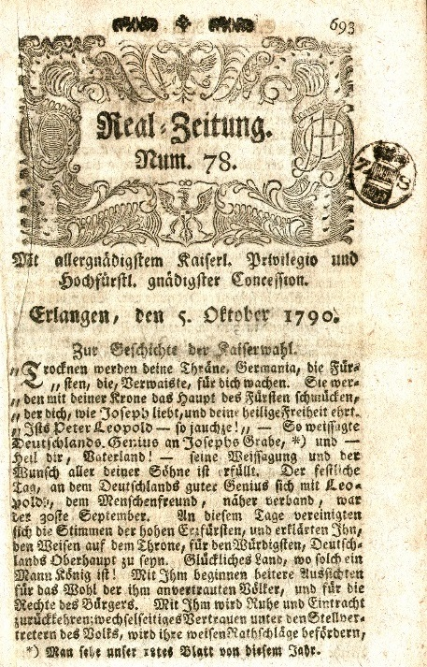
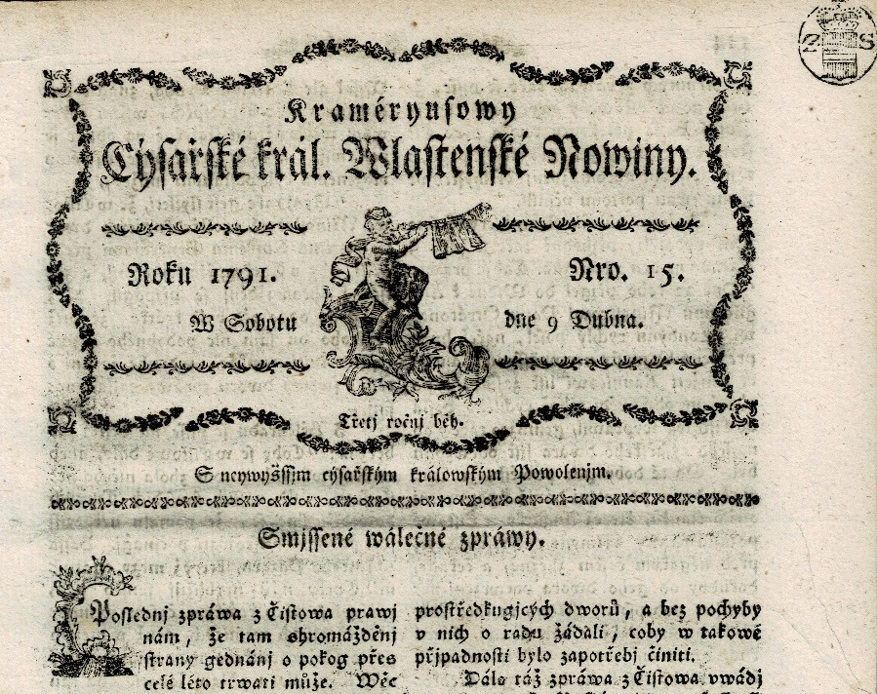
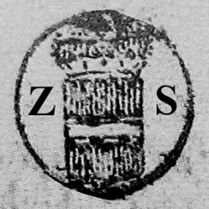
April/May 1790 to 1791: newspaper tax now shown by coat-of-arms in circle with letters ZS
5 October 1790 | 9 April 1791
Notes:
Click for next
From April/May 1790 to 1791, newspaper tax was shown by a coat-of-arms in circle with letters Z S – no reason for this change has been found. Maybe another Josef-initiative?
Prague also tried a signet with B S for Brochures. Didn’t catch on, and there’s only two copies known, both in museums.

Slide 12
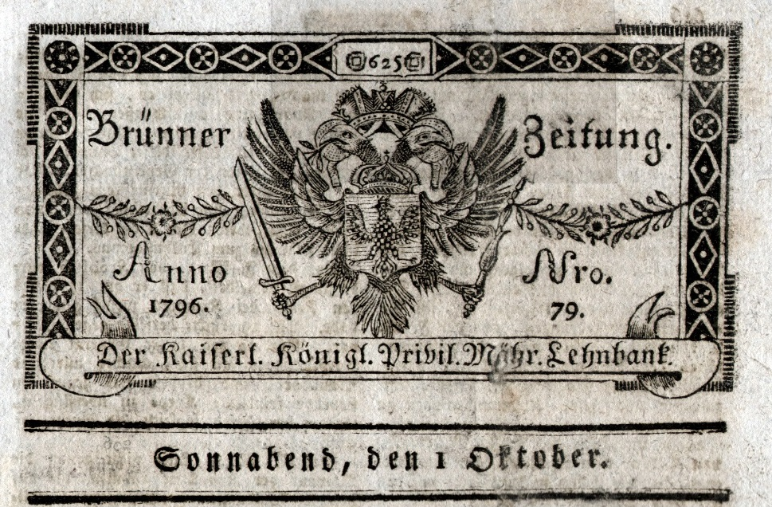
September 1791: newspaper tax abolished - no marking
Saturday 1 October 1796
Notes:
Click for next
Accusations of a “tax on knowledge” and “interference with Press freedom” led to more and more exemptions. On 12 July 1789 scientific journals were exempted, on 28 February 1790 folk-songs, in September 1791 original newspapers. By 1792, the tax was effectively abolished.

Slide 13
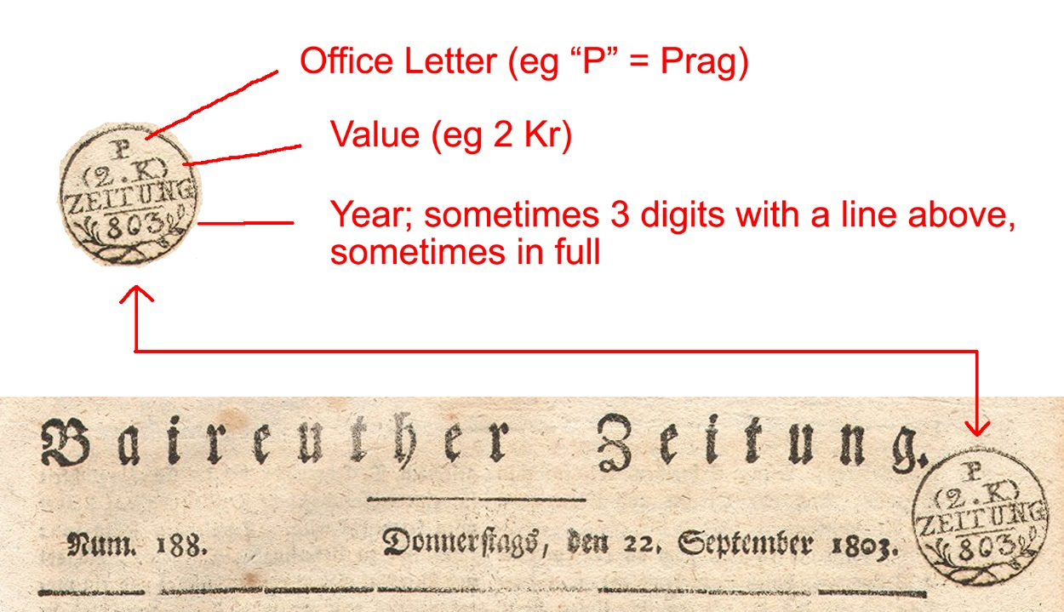
1803: the tax returns
The rates were ½ kr for inland newspapers smaller than 1 Bogen; 1 kr if 1 Bogen or bigger. Foreign newspapers paid double these rates. The tax signet design was changed every year up to 1850.
Notes:
Click for next
The tax returned in 1803. A starting date of 1 March for the restored tax is given by Frankl and attributed to a Hofkammerdekret, but the Austrian State Archive has no trace of this document! This is quite normal – they would have been handwritten, not catalogued, and are probably in the bottom drawer of a locked filing cabinet stuck in a disused lavatory with a sign on the door saying ‘Beware of the Leopard”.
In the Staempelpatent of 5th October 1802, the date of introduction is clearly stated as 1 January 1803. The rates were ½ kreuzer for inland newspapers smaller than 1 Bogen; 1 kreuzer if 1 Bogen or bigger. Foreign newspapers paid double these rates. The tax signet design was changed every year up to 1850, and the display contains at least one example for every year.

Slide 14
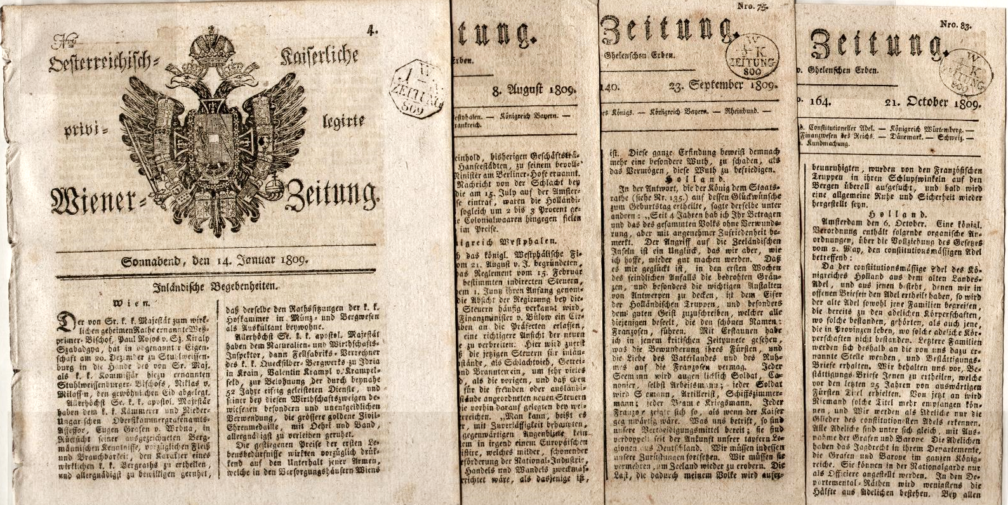
1809 – Napoleon in Vienna
14 Jan: Austrian Arms & tax ¦ 8 Aug: no arms or tax ¦ 23 Sep French tax ¦ 21 Oct French gone, their signet remains!
Notes:
Click for next
Napoleon’s army entered Vienna on 13 May 1809, remaining until 14 October. One minor effect of this can be seen on the masthead of the Wiener Zeitung for that year, which had the Austrian Eagle and Austrian octagonal tax signet until 6 May. When Napoleon appeared, the Austrian Government officials hid everything concerned with signetting, to prevent Napoleon getting the tax revenues. However Napoleon played by his own rules, and simply introduced his own signet. The Austrians hadn’t thought of that!

Slide 15
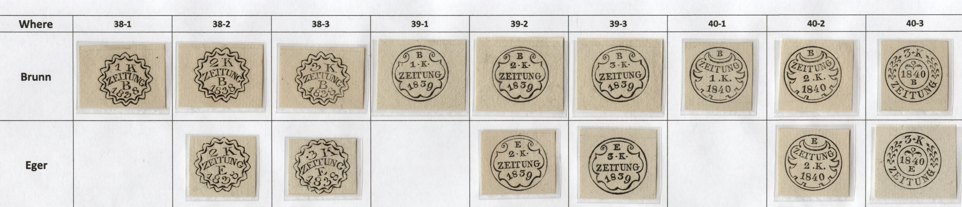
“Specimen Signets”
Several collections exist comprising superbly-printed impressions of the year-dated newspaper signets.
Notes:
Click for next
“Specimen Signets”
Several collections exist comprising superbly-printed impressions of the year-dated newspaper signets, on stiff high-quality paper. They are basically identical, and definitely don’t appear to have been made over a 25-year period. One possibility is that each year the new signets were distributed and the old ones returned to Vienna; after 1850, copies of each were made before the signets were recycled as scrap metal; after 1918 these “came on to the philatelic market”.
A collector might wish to obtain one copy of each dated signet for every year from all signetting offices. There were 3 signets each year from 1803 to 1841, and 2 from 1841 to 1850. There were 15 signetting offices. So you need 137 signets from each of 15 offices, a total of 2055. What-I-have is next – omitting the Gap Years which nobody has.

Slide 16
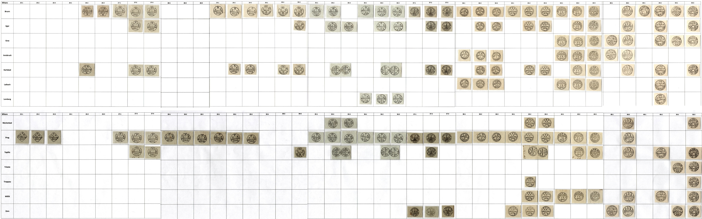
Notes:
This scrolls across, then jumps to next slide.

Slide 17
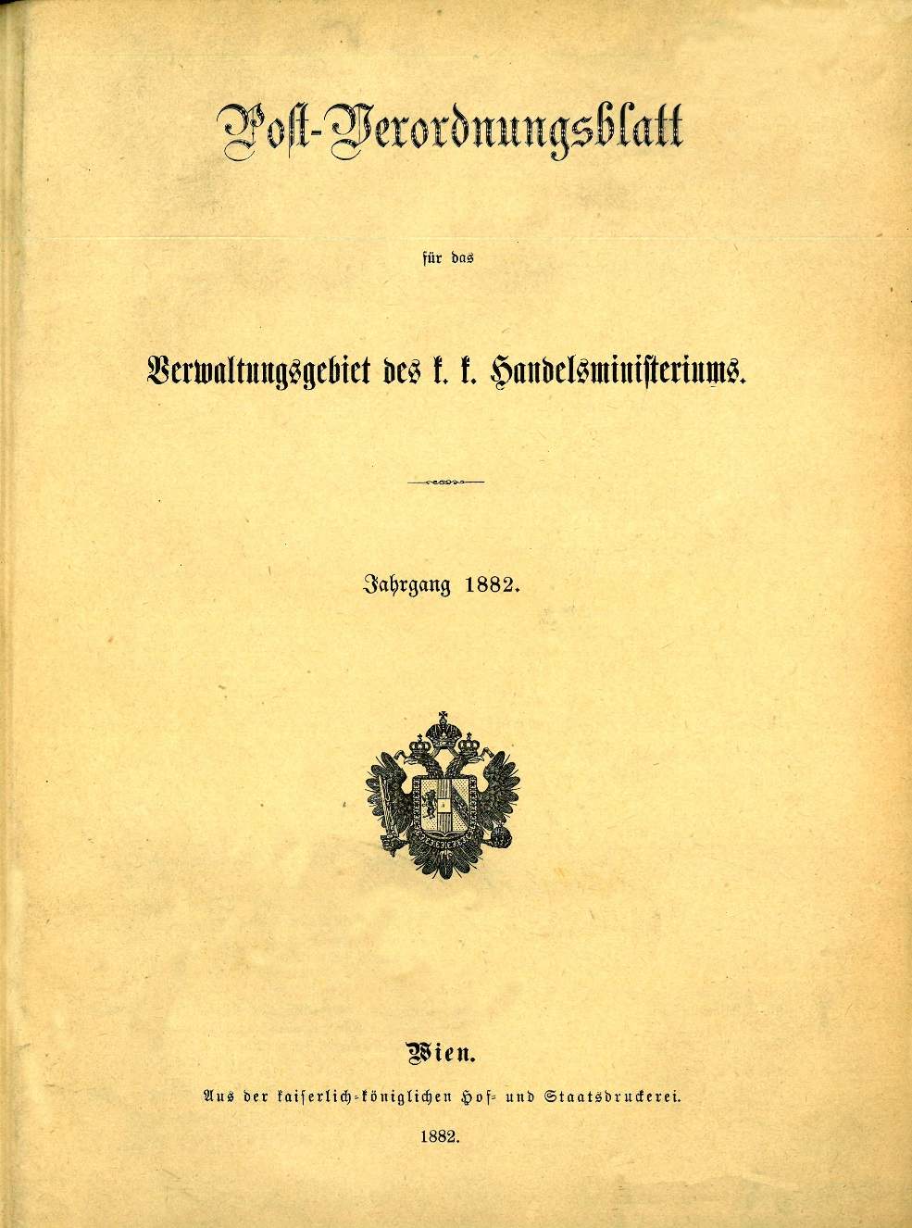
How to order a newspaper:
First, read the 62-page instruction manual.
Notes:
Click for next – then it autoruns to green mercury
Ordering a paper is simple bureaucracy – and of course fully documented. Go to your Post Office and they will guide you through the process…

Slide 18
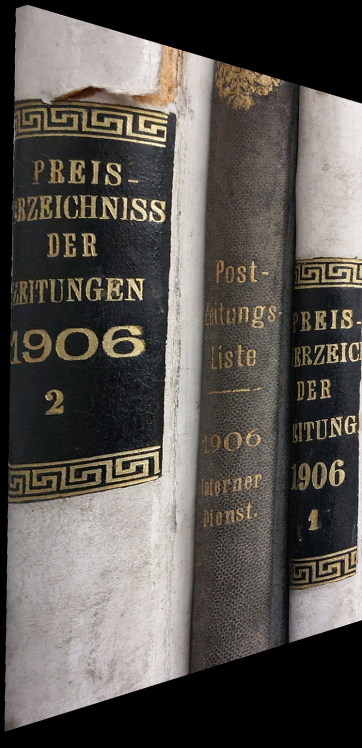
Next, consult the lists of what is available.
Foreign? Inland?
Did the censors approve it?
Notes:
autorun

Slide 19
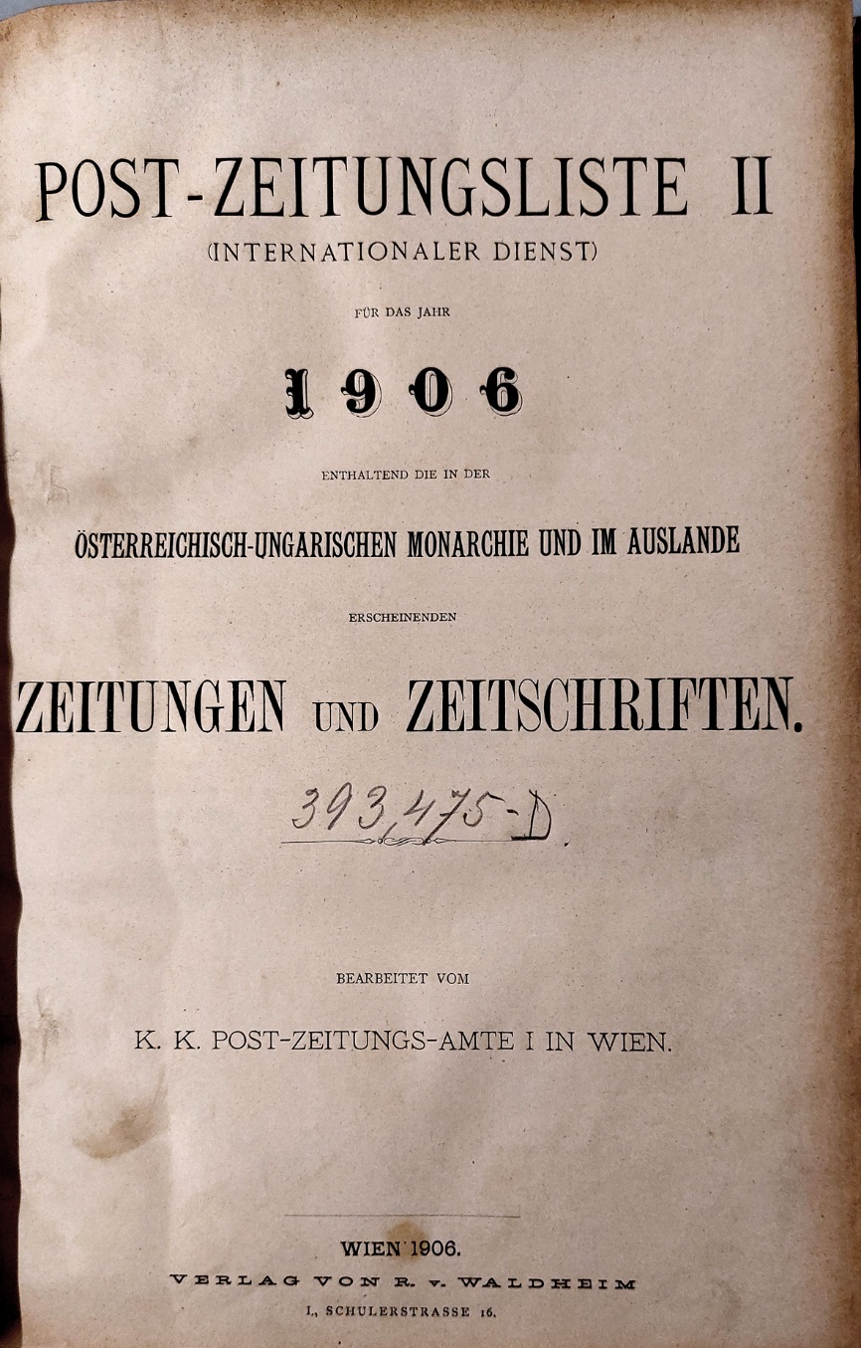
Here’s the foreign list for 1906.
Notes:
autorun

Slide 20
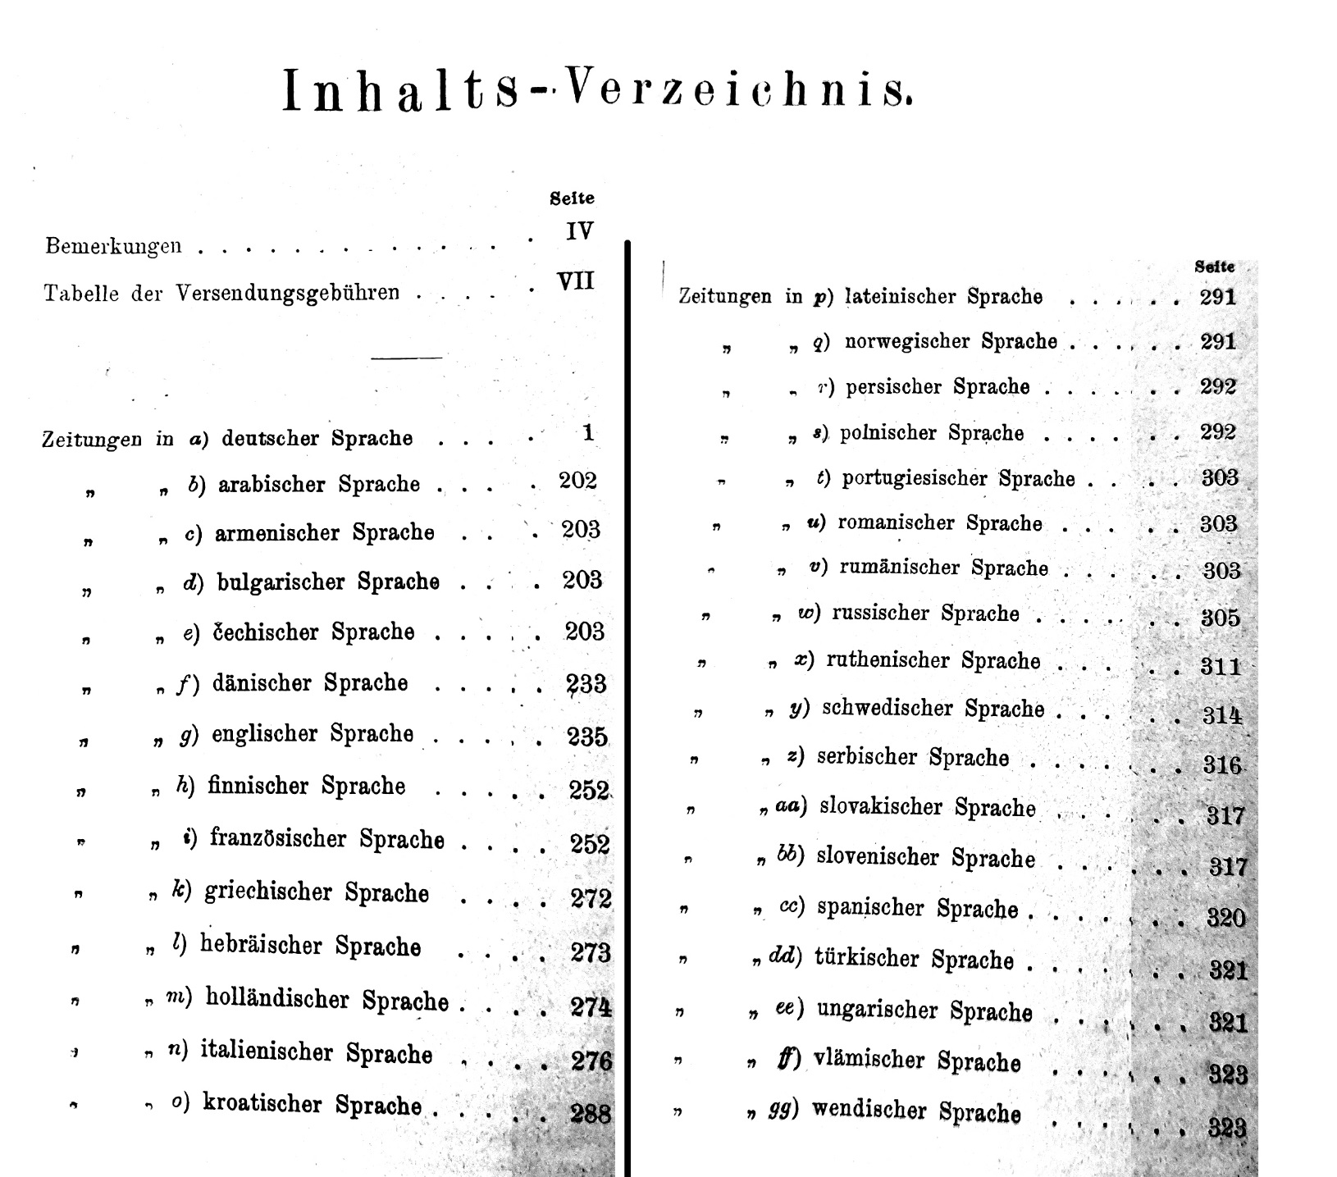
There are 33 languages listed!
Notes:
autorun

Slide 21
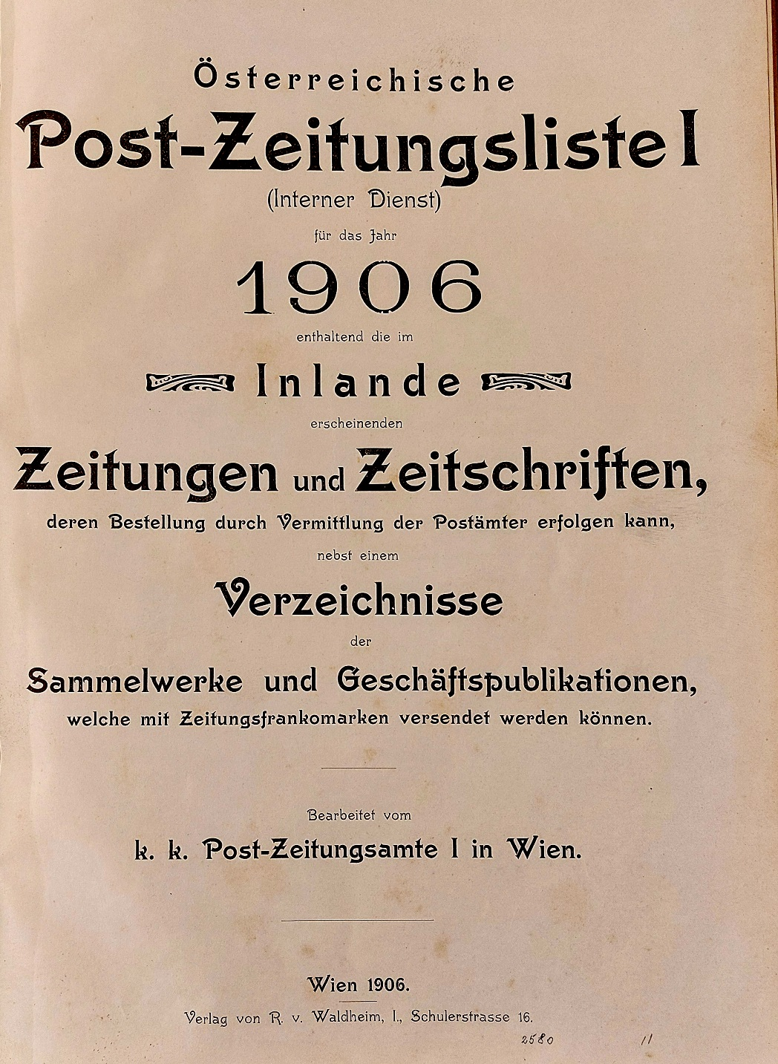
Maybe you want an inland newspaper…
There’s only 15 languages to choose from.
Notes:
autorun

Slide 22
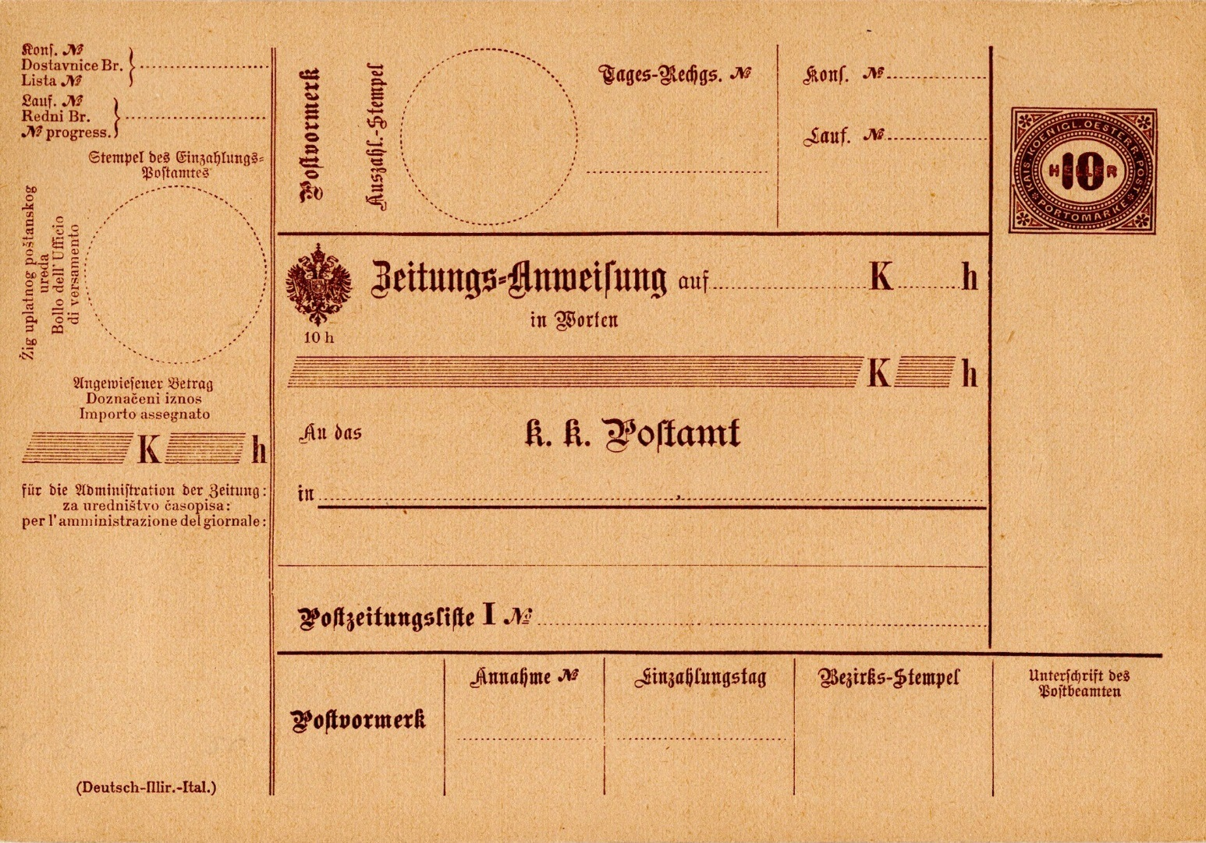
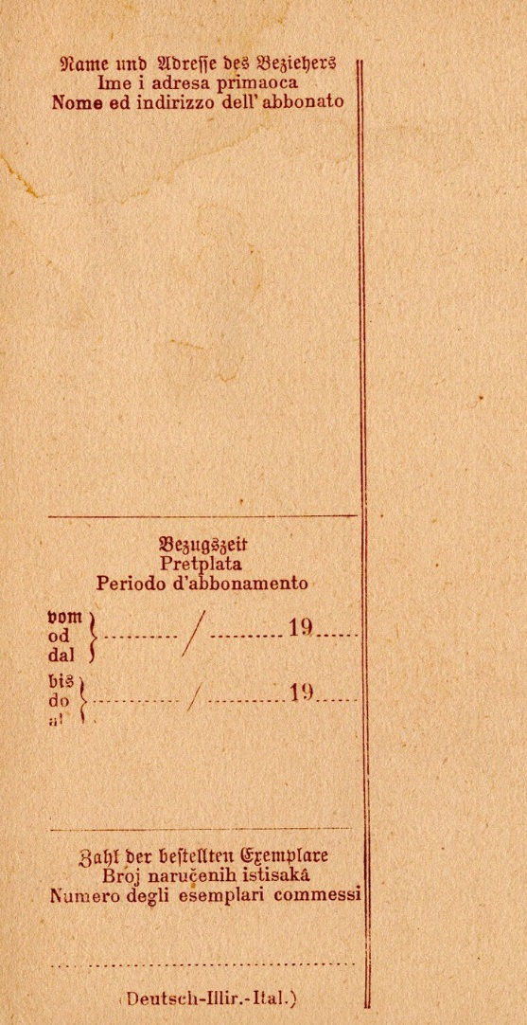
Buy the form; fill it in. There are 8 different language versions; this is the German-Illyrian-Italian one.
Notes:
autorun

Slide 23
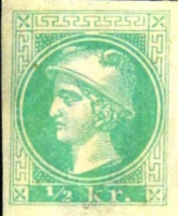
Decide if you want it delivered to your house, or if you will collect it from your Post Office.
If you choose delivery, negotiate a price with your postmaster. Later, the charge was centrally fixed at ½kr. From 1880 it was shown as included in your subscription by an extra green postage stamp.
This only worked if your office was state-owned.
Pay!
Notes:
Click for next
Post Office would be near – or in – a café so having to go there was not necessarily bad.

Slide 24
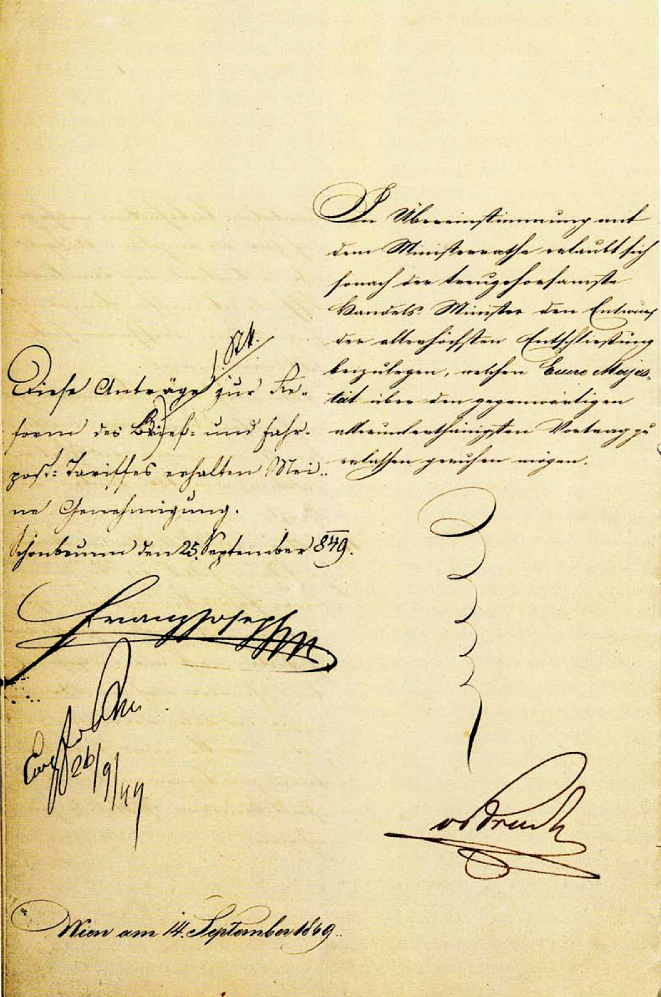
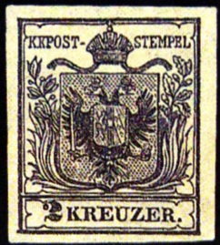
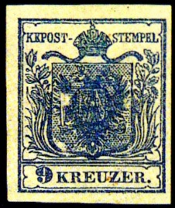
1849: A total reform of the postal system, including Adhesive postage stamps was humbly proposed by Ritter von Bruck “the most loyal Minister of Commerce”. The Emperor was graciously pleased to agree, signing the official document.
These proposals for the reform of the letter and postal tariffs receive my approval.
Schönbrunn, September 25, 1849.
Franz Joseph
Postage stamps for the letter and carriage mail were introduced on 1 June 1850.
Notes:
Click for next
The grovelling was part of Court Etiquette – based on that of Spain. Franz Joseph insisted on its strict observance.
There had been a tariff reform in 1842, simplifying the rates. Von Bruck had sent a Dr Johannes Hertz on a study tour of foreign systems, including Bavaria, Belgium, and the new-fangled British. His report recommended adhesive postage stamps.

Slide 25
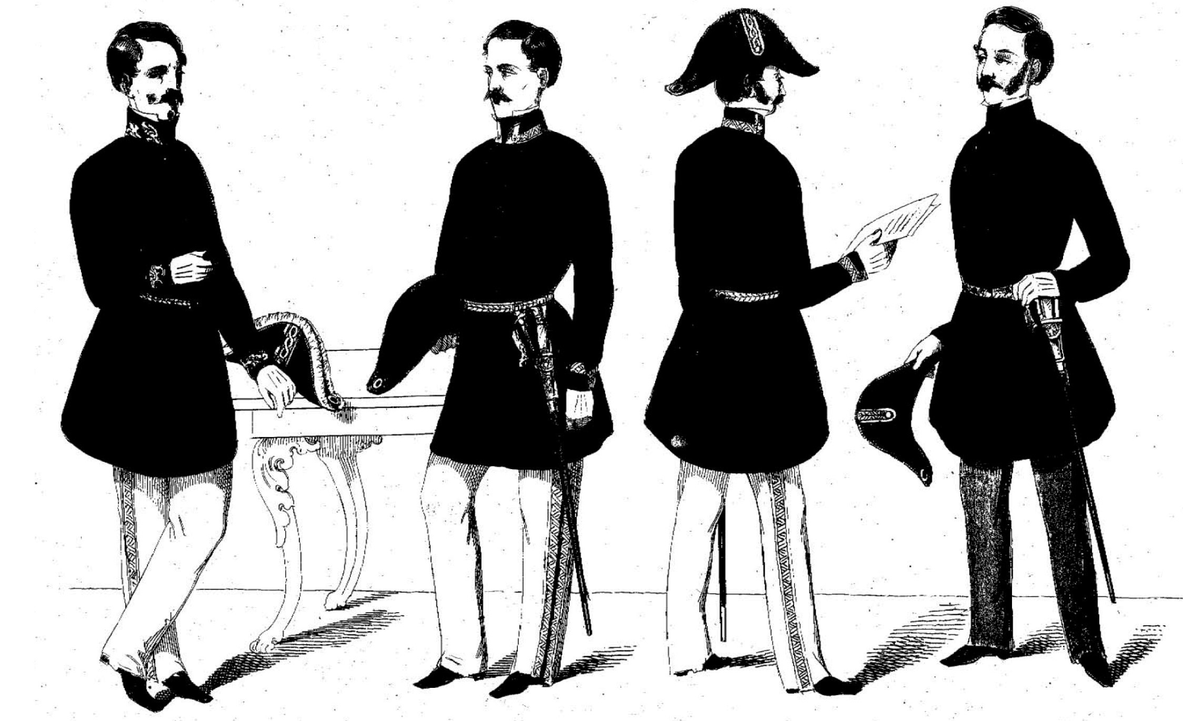
And a new uniform to go with the new service!
Notes:
Click for next
This picture is from a Law issued in Lombardy, illustrating the 11 classes of Beamte (Civil Servant). The collars were colour-coded to show which Ministry they belonged to – eg the Finance Ministry wore light green.
Note the man on the left. You can tell he’s senior, possibly even the Minister, by his nonchalant stance, the frills around his hat, and the scrambled egg on his collar. He is performing a function vital to the security of the state. The table only has legs at the left end, so if he removes his arm the table will fall over.

Slide 26
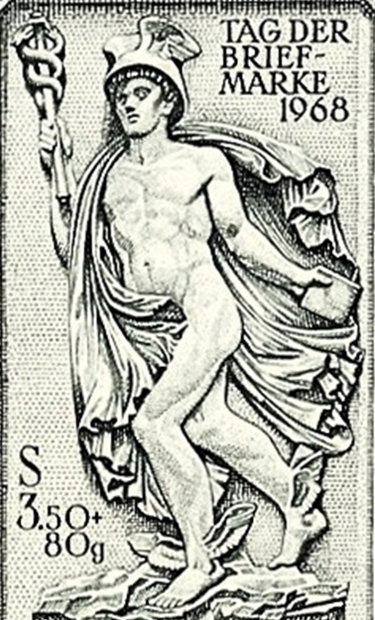
Discussions began on posting newspapers,
and the design of special stamps.
Notes:
Click for next
Discussions began on posting newspapers, and on the design of special stamps
The messenger of the Greek gods was Hermes, known as Mercury to the Romans. He was a pastoral god, protecting livestock and travellers. His symbols include the caduceus – a staff with two intertwined snakes – as well as his winged sandals and cap.
God of boundaries, roads, travellers, merchants, thieves, athletes, shepherds, commerce, speed, cunning, language, oratory, wit, and messages. Obviously suited to symbolise newspaper post. Although a very busy man, he found time to have 18 children!

Slide 27
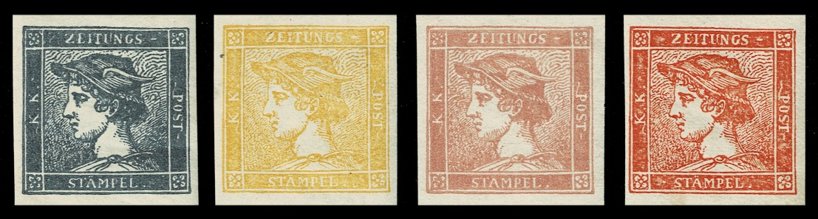
In 1850, the introduction of adhesive postage stamps for newspapers was agreed by the Ministries on 12 September. They were first used on 1 January 1851.
Notes:
Click for next
The design was the famous Blue Mercury. Blue was for 1 paper; Yellow for a packet of 10; Rose for a parcel of 50. Later, it was discovered that blue stamps could be bleached into yellow ones, so they were replaced by Red.
They were sold at a substantial discount, but only in sheets of 100 for cash and only to registered publishers. A sheet of 100 Rose stamps cost 50 Gulden in cash in advance. The equivalent of this sum in today’s purchasing power is 1014 Euro!
The yellow and the rose were withdrawn, redenominated as 1 kreuzer, and used up by a Vienna publisher.
The red died at the 1858 currency change.

Slide 28
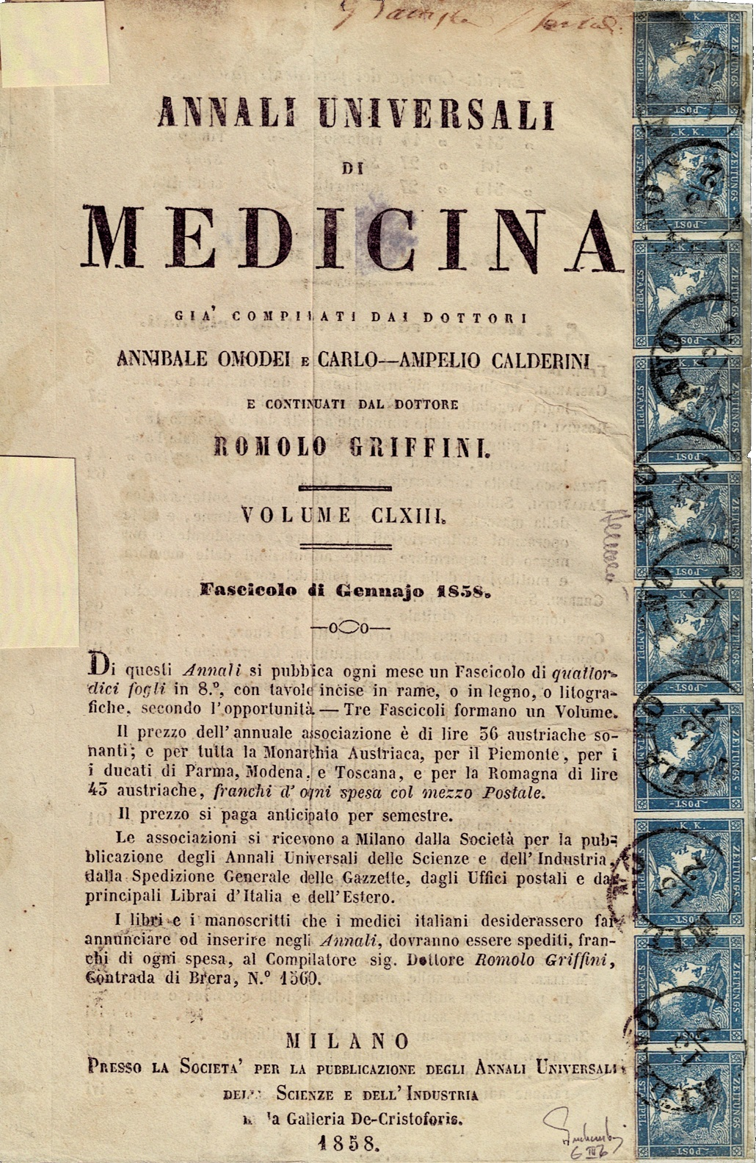
Blue Mercury type IIIb, horizontal strip of 10 tied to front cover of Annali Universali di Medecina, volume 163, the Fasciolo (issue) for January 1858. Published in Milan; cancelled MILANO 13/2 (7 impressions). Used to send a bundle of 10 copies.
Not unique - one other is known.
Notes:
Click for next

Slide 29
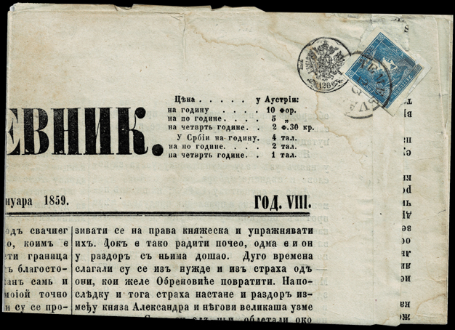
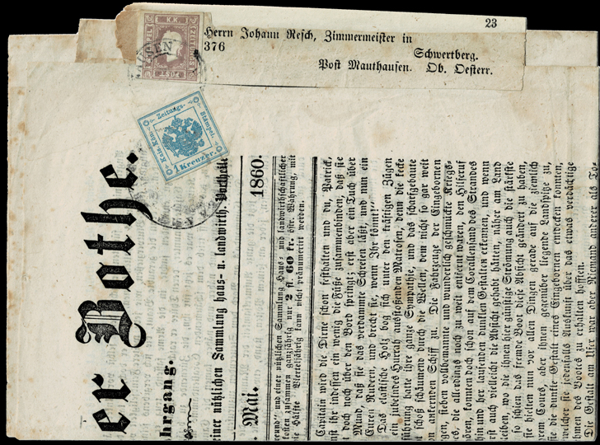
The CPБCКИ ДΗЕΒΗИК, the Serbian Daily for 8 January 1859. Franked with a revalued 1851 adhesive; posted to Temesvar and cancelled there. Taxed 1kr, shown by signet nr 126 applied in the tax office in Szegedin.
The Pusterthaler Bothe of 18 May 1860, sent to Schwertberg / Post Mauthausen. The postage is paid with a lilac-coloured 1858 adhesive on the address label. The newspaper tax is paid with a blue 1858 1kr tax adhesive, cancelled at an Austrian Fiscal Office.
Notes:
Click for next
[The Serbian Daily for 8 January 1859. Franked with a revalued 1851 adhesive; posted to Temesvar and cancelled there. Taxed 1kr, shown by signet nr 126 applied in the tax office in Szegedin.]
[The Pusterthaler Bothe of 18 May 1860, sent to Schwertberg / Post Mauthausen. The postage is paid with a lilac-coloured 1858 adhesive on the address label. The newspaper tax is paid with a blue 1858 1kr tax adhesive, cancelled at an Austrian Fiscal Office.]

Slide 30
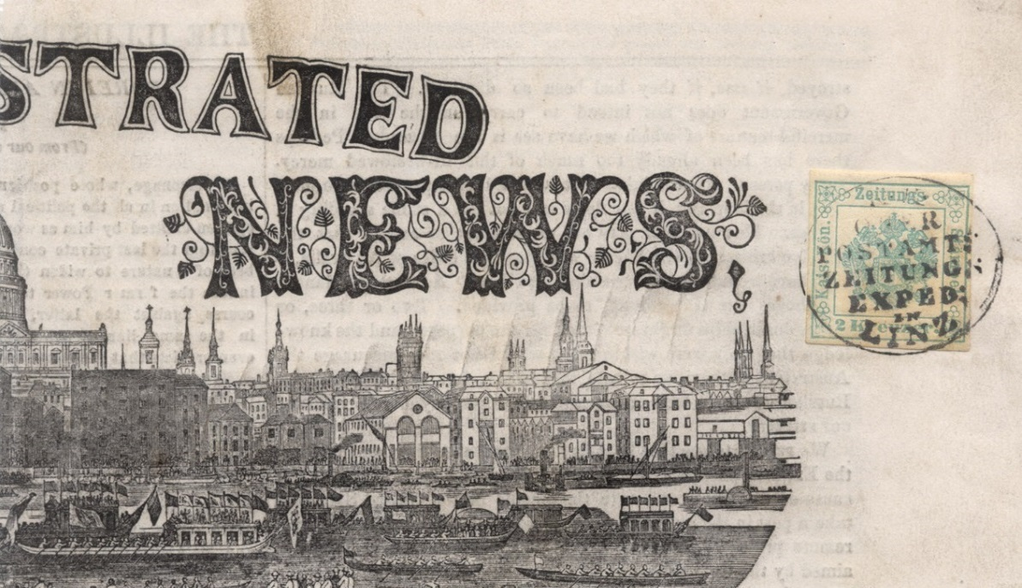
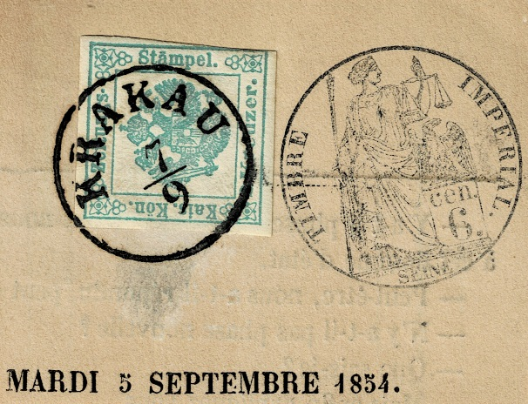
In 1853, the first Newspaper Tax adhesive stamp (the 2 kr green) was introduced on 1 March to pay the tax on foreign newspapers that had not been ordered by Postal Union subscription.
1853 issue, type Ia, unusually intense green, cancelled KRAKAU 7 September 1854. On piece of a French newspaper with a 6cen French tax mark.
1853 issue, type Ia, rather faint, on the Illustrated London News of 3 June 1854. Cancelled at the Linz Post Office newspaper section
Notes:
Click for next
After a year or so of Civil Service discussions, the first Newspaper Tax adhesive stamp (the 2 kreuzer green) was introduced on 1 March 1853 as a way of paying the tax on foreign newspapers that had not been ordered by Postal Union subscription; these typically arrived in a Kreuzband (wrapper) or were brought in by travellers.

Slide 31
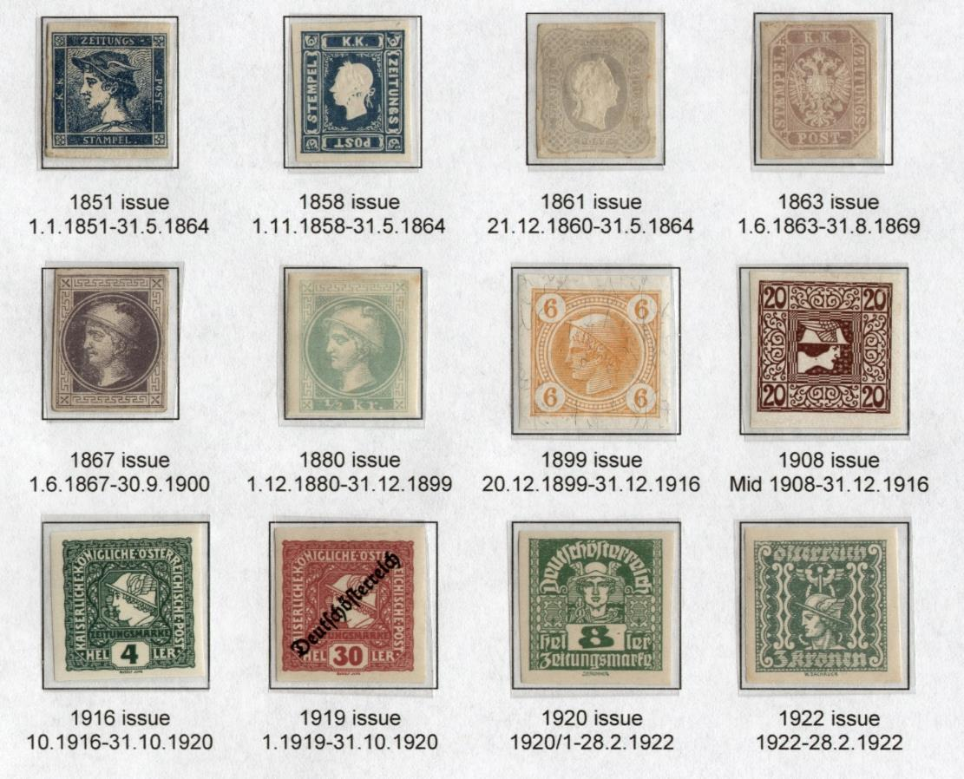
An overview of the Newspaper Postage Stamp issues.
Notes:
Click for next
An overview of the Newspaper Postage Stamp issues from 1851 to 1922.
31

Slide 32
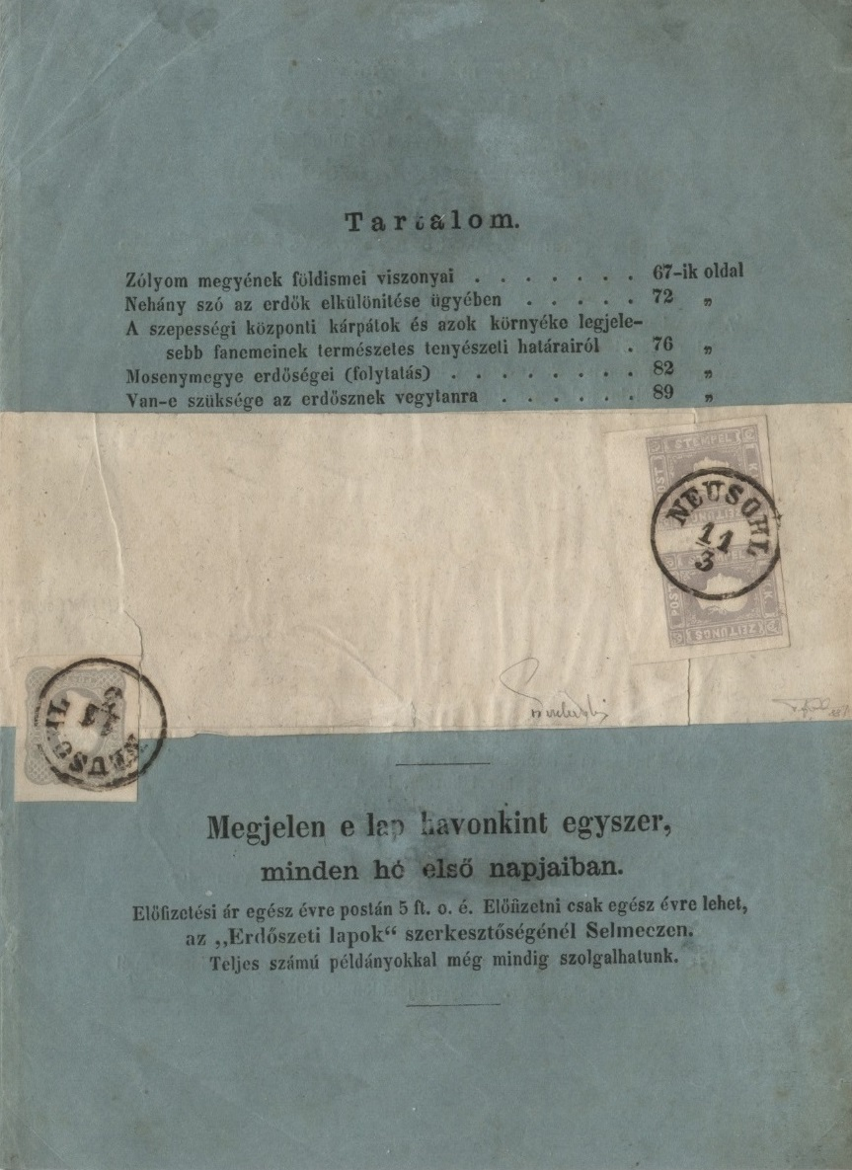
Extremely rare mixed franking – a pair of the 1858 postage stamp issue with a single of the 1861 issue.
On the original wrapper of the Forestry Newspaper.
Notes:
Click for next.
The 1858 stamps were valid until the currency change in 1900; likewise the 1861, 1863, and 1867 issues – but late usage is rarer than hens teeth.

Slide 33
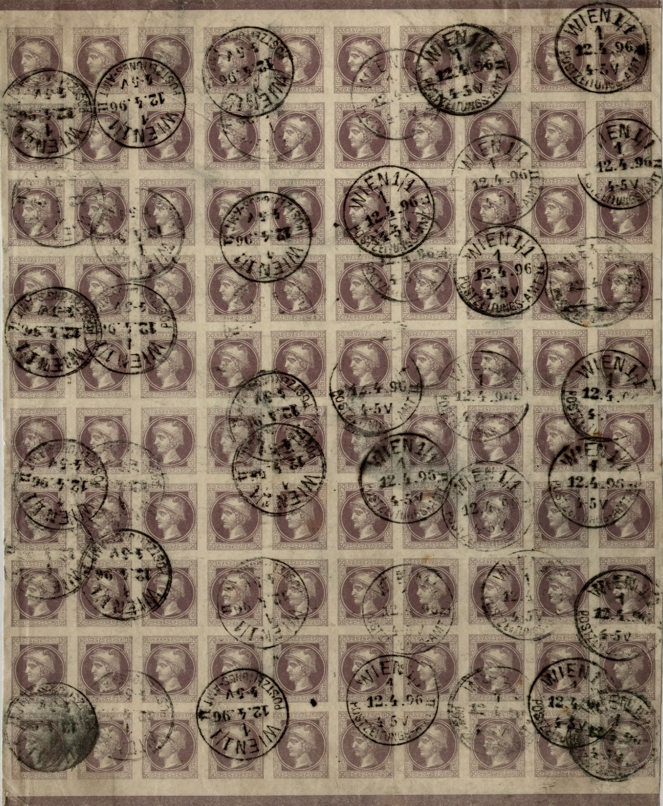
1867 postage stamp issue.
Complete counter sheet of 100 stamps as sold to publishers.
The display also shows a mock-up of the printed sheet, which had four of these blocks arranged 2x2.
Notes:
Click for next
This has been used to send a parcel of 100 newspapers.

Slide 34
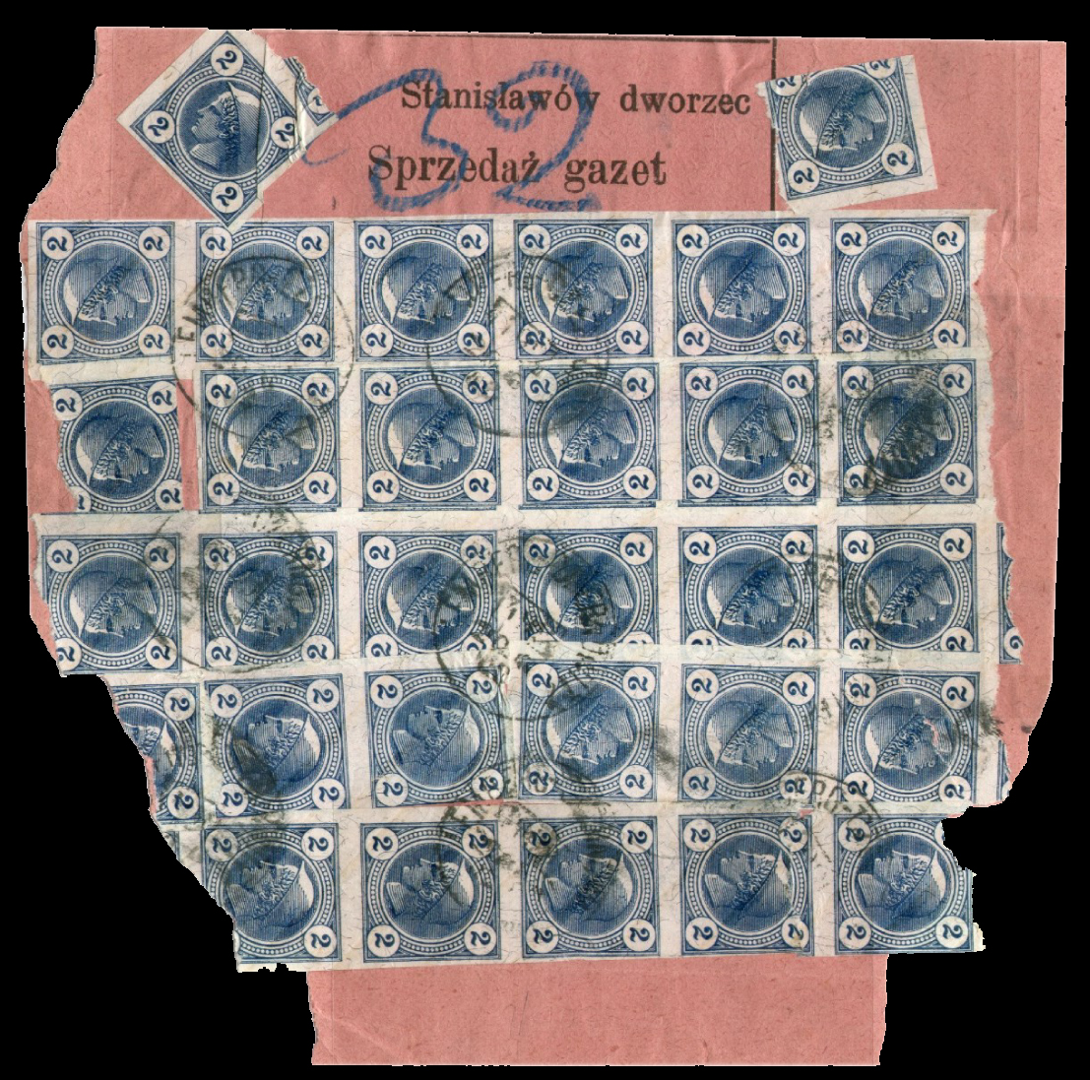
The Zeitungsverschleißer.
Wrapper with thirty-two 2 h newspaper stamps containing 32 newspapers for delivery to the paper-shop at Stanislawów railway station. Cancelled on 20 June 1902 on the Lemberg-Czernowitz Nr 381 Travelling Post Office..
Notes:
Click for next
Verschleiß is a good example of Österreichische Amtssprache – Austrian bureaucratic jargon. In German it means something like “newspaper recycling“.
However in Austrian, Verschleiß is retail trade; so a Zeitungsverschleißer is a registered newspaper retailer, who could arrange to collect his newspapers directly from the railway station instead of waiting for the Post Office to deliver them next day. The label of the package had to be red.

Slide 35
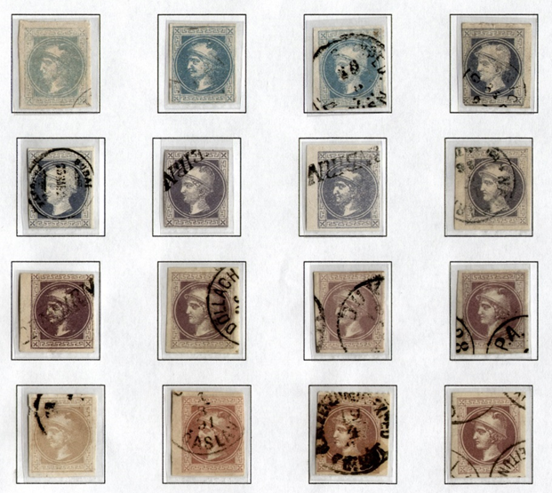

It’s estimated that two thousand million (2,000,000,000) copies of the 1867 stamp were made!
It is notorious for colour variations – Ferchenbauer lists 14, the latest ANK catalogue 33. Why so? The ink is water-soluble and light-sensitive; the paper contained Fe & Cu.
The primary colourant is “Mauveine”, discovered as a dye by William Henry Perkin in 1856; he was actually trying to make quinine for treating malaria! It seems to be a chemical soup with variable amounts of four related 5-ring aromatic compounds. Research in 2008 found 8 more!
Further reading:
https://www.nature.com/articles/s41598-017-07239-z
Notes:
Click for next.
Perkin was experimenting with a mixture of aniline and toluidine (flammable, carcinogenic etc etc). A black sludge appeared in his flask, but being an observant young lad he noticed a purple sheen and followed it up.
It’s superb for dying silk, eg Queen Victoria’s dresses. Less so as a stamp printing ink – although they probably wanted speed and cheapness, and weren’t too worried about it lasting 160 years.

Slide 36
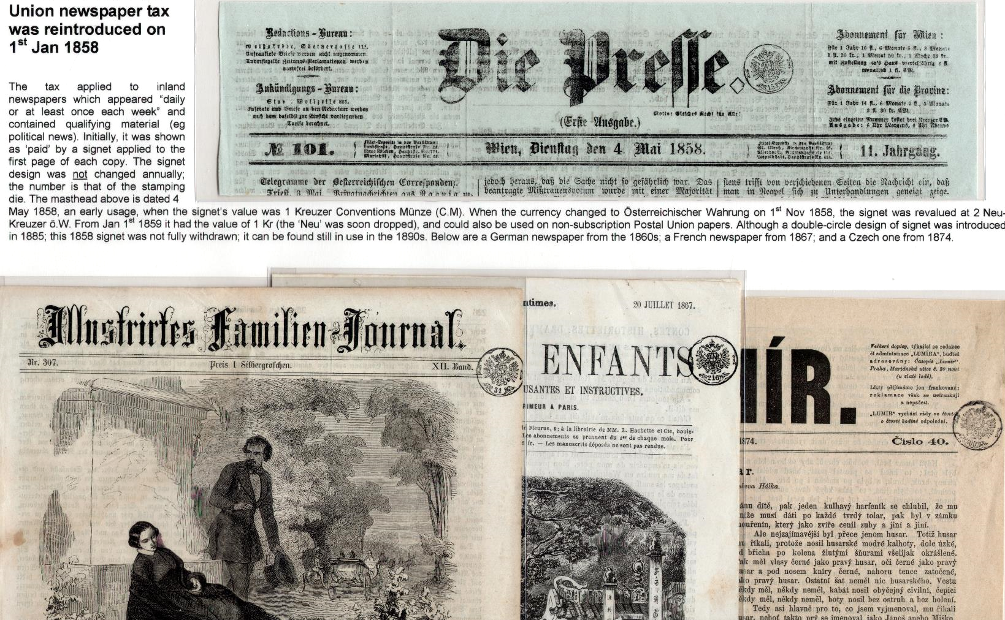
Signets 1858 - 1900
The inland and Postal Union newspaper tax was reintroduced on 1 January 1858.
Note the new design of signet. Each is numbered.
Notes:
Click for next
The new signets were smaller, and equally complicated in design. Each had a unique number, and they were not changed annually.

Slide 37

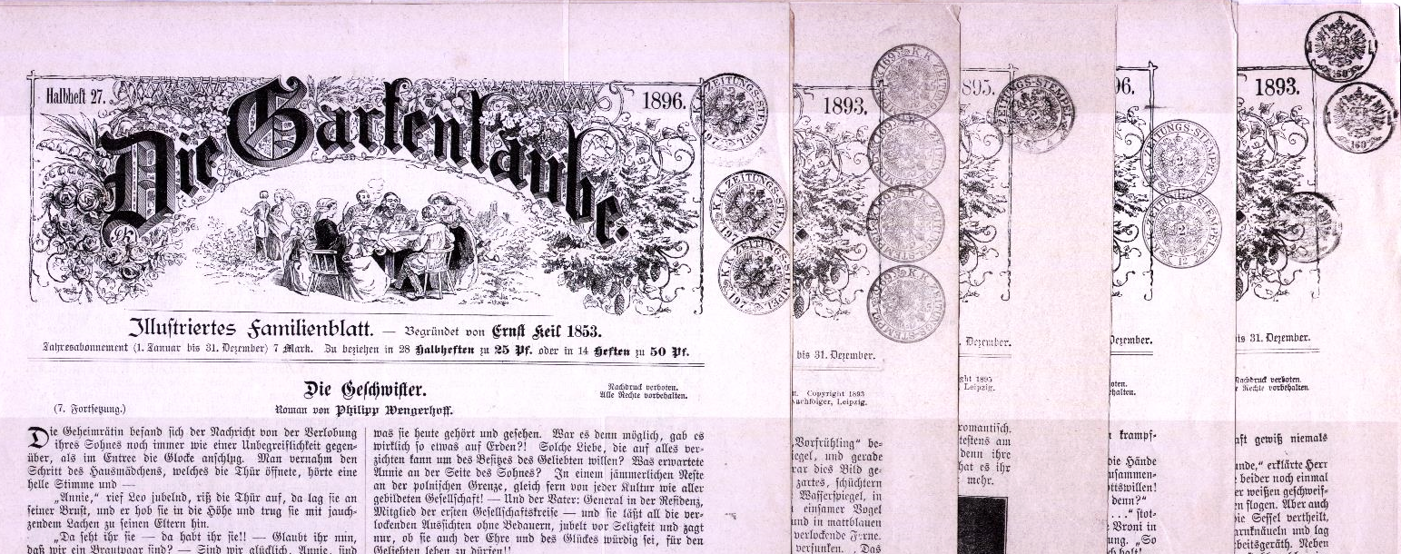
1890: 2kr signet introduced in Lemberg, later in Vienna. Multiple signetting of the top copy of bundles is common. That makes the other copies illegal!
Notes:
Click for next
Most likely is that these bundles were sent as a monthly subscription order of weekly issues to a private household. Then they’d not leave the house, so the Tax Police wouldn’t intercept them.
The blue arrow marks the use of two two-kr signets, paying a tax bill of 4 kr.

Slide 38
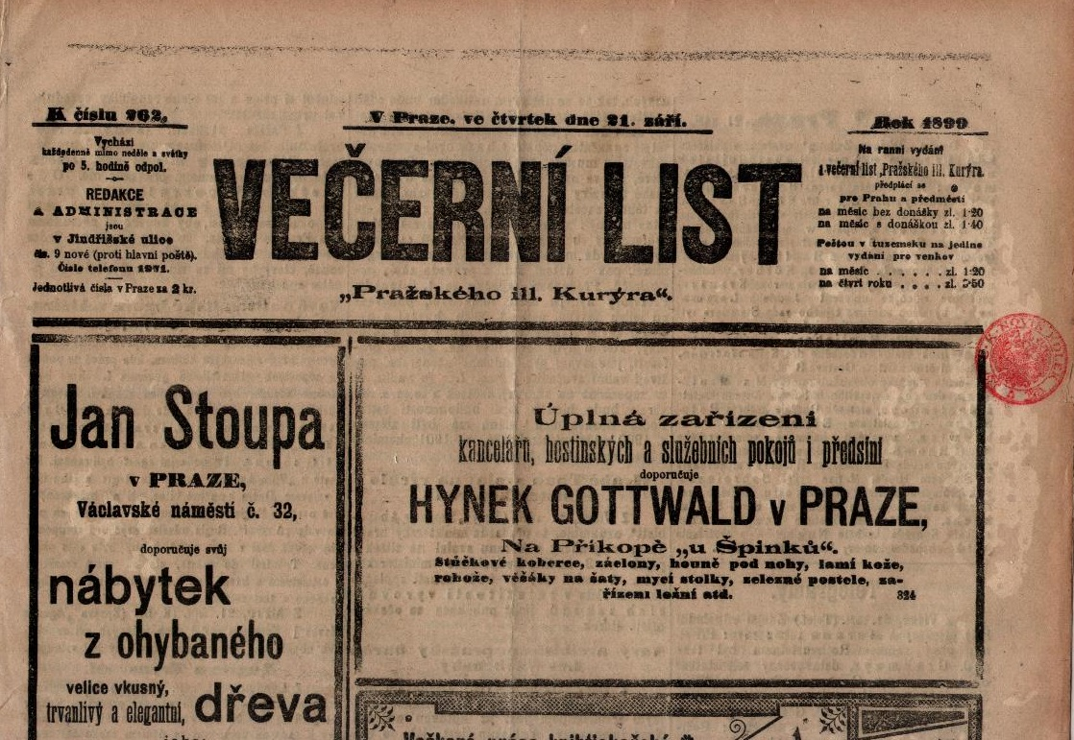
This paper has a red signet showing that it had a companion morning issue (the Kuryr) and was thus exempt from tax. The signet has Czech wording (C K NOVIN KOLEK) as introduced in May 1898 for newspapers “printed in Bohemian”.
Notes:
Click for next
The red signet isn’t always used where it should have been. I suspect the intricate design of the signet was a nuisance to clean – and this paper would be printed on a rotary press.
There are also BLUE signets, used for special editions.

Slide 39
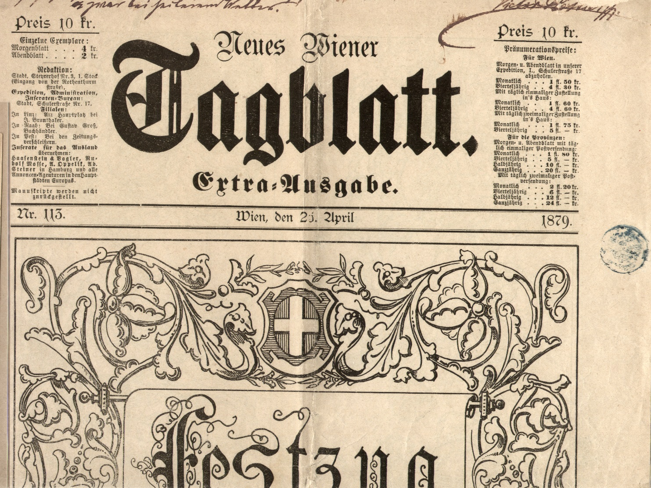
Notes:
Click for next
An extra edition of the Neues Wiener Tagblatt dated 26 April 1879, produced to mark the ceremonial procession for Kaiser Franz Joseph and Kaiserin Elisabeth’s silver wedding. Blue signet.
Shown in Frame 26. The illustrations make it look like Jeux sans Frontiere for old men!

Slide 40
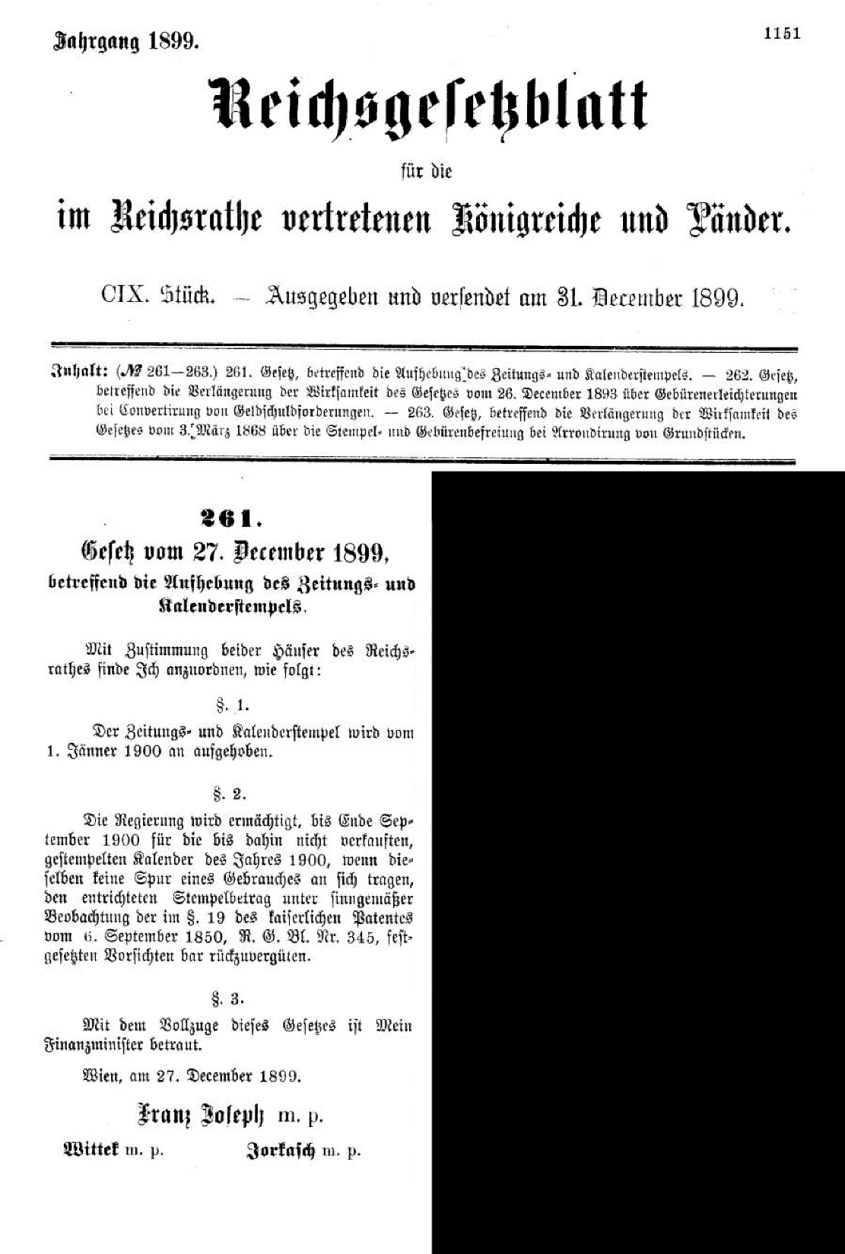
NEWSPAPER TAX WAS ABOLISHED ON 1 Jan 1900
Austria moved to Gold Standard currency in the 1890s, and the new currency of “1 Krone of 100 heller” was introduced to the Postal Service on 1 January 1900.
What to do about the newspaper tax?
Boldly going where none had gone before, it was ABOLISHED!
Notes:
Click for next
New currency! What to do about the newspaper tax? In an unusual step for Austrian bureaucracy, it was ABOLISHED!

Slide 41

The 1899 Newspaper Post Issue
With the introduction of the “1 Krone of 100 Heller” currency, new newspaper post stamps were issued on 20 December 1899.
1901-1905: slanting varnish stripes: prevention of reuse.
Wrappers printed to private order have the stamp printed in a washed-out light green instead of blue.
Notes:
Click for next
The 1899 newspaper stamp issue
The 1899 issue comprised 2 Heller blue, 6 Heller orange, 10 Heller brown and 20 Heller rose stamps for one, three, five or ten newspapers. From 1901 to 1905, slanting varnish stripes were added to prevent reuse – it didn’t work.
The blue stamp was used unusually frequently; more than a thousand million were printed. The other stamps were not much used, and the higher values are rare on whole pieces, since they were pasted on the packaging which was discarded. The stamps were valid until 31 Dec 1916.
This issue is also found on postal stationery, especially on wrappers printed to private order. The colour was changed however, the 2 Heller value to washed-out light green instead of blue.
41

Slide 42


The Jugendstil 1908 issue, valid from mid-1908 to end 1916.
Notes:
Click for next.
The 1908 stamp issue, commemorating the 60th anniversary of Emperor Franz Joseph, was the first issue which was consciously conceived as a work of art. It was in the Jugendstil style (Austrian Art Nouveau) by the renowned artist Professor Koloman Moser. The newspaper stamps had the Mercury head, no inscription, large value numerals, no perforations. There were 2 heller blue, 6 heller orange, 10 heller red and 20 heller brown. Three kinds of paper.

Slide 43


1916 - new Kaiser, new designs
Unusual coloured copy of the Postverordnungsblatt informing the Postal Staff of the introduction of a new design of Newspaper Post stamps - no change in the face values.
Notes:
Click for next
The newspaper stamp issue of 1916 was produced mainly to raise funds for the war. It used a new drawing by Dr Rudolf Junk, which features a long inscription "KAISERLICH KÖNIGLICHE ÖSTERREICHISCHE POST" around the Mercury head plus an almost invisible ZEITUNGSMARKE just above the value number. Numerous private perforations exist, sometimes very sloppy; and double perforating frequently occurs. The colours changed yet again; there were 2 heller brown, 4 heller green, 6 heller blue, 10 heller orange and 30 heller lilac-red.
Private printings occur: the 2 heller stamp is red instead of brown.

Slide 44



The 1919 “Deutschösterreich” overprints (valid from 1.1919 to 31.10.1920)
From December 1918 the five 1916 newspaper stamps were issued overprinted “Deutschösterreich” (“German-Austria”), to publicise the Austrian desire for German unity.
When the Deutschösterreich overprints were commissioned, trials were done to compare a horizontal and a diagonal overprint. The horizontal although easier to print was much less visible, so the diagonal was chosen.
Notes:
Click for next
After the end of WWI, Austria emerged as a battered residue convinced that its only hope of survival was by uniting with Germany.
France objected vehemently, and Germany was discouraging.
From December 1918 the five 1916 newspaper stamps were issued overprinted “Deutschösterreich” (“German-Austria”). They were valid till 31 Oct 1920. In other successor states of the Empire, the Austrian stamps were suitably overprinted and used until replacements could be produced.

Slide 45
Post-war inflation – a trap for the unwary
1st: 12 Nov 1918 to 30 June 1920 | 2h, 2h, 2h
2nd: 1 July 1920 to 31 Mar 1921 | 6h, 10h, 15h
3rd: 1 April 1921 to 30 Sept 1921 | 9h, 15h, 30h
4th: 1 Oct 1921 to 31 Dec 1921 | 18h, 30h, 60h
5th: 1 Jan 1922 to 28 Feb 1922 | 45h, 75h, 150h
** From 1 July 1920 there were three basic inland newspaper rates: an up-to-35-gram newspaper posted flat; a heavier paper posted flat charged per 50 grams; and a heavier paper posted in a roll charged per 50 grams.
Notes:
Click for next.
Post-war inflation – a trap for the unwary philatelist!
Inflation hit the newspaper post just as for everything else. However, the changes in postage rates made to cope with it were at different dates from the changes in the ‘ordinary post’. The Austrian literature refers to “Inflation Periods 1, 2 etc” BUT these are quite different from the letter-mail inflation periods and there are only 5 of them. The starting date of 12 November 1918 is chosen because it is the date the Republic of Deutsch-Österreich was proclaimed; the rate of 2 heller introduced on 1st January 1900 didn’t change until 1 July 1920.

Slide 46


The 1920 “Renner” issue and the 1922 “Dachauer” issue – both named after their designers.
From Wednesday 1 March 1922, newspaper postage stamps were withdrawn; payment had to be made in cash.
Notes:
1920: When the postage rates increased on 15 Jan 1920, newspaper stamps in new values and a new design were required. The “Renner-issue” (named after the designer J F Renner, not the politician Karl) showed Mercury full-face surmounted with “Deutschösterreich”. As inflation bit, new values were issued up to 3 Krone, and the series finally included 19 values. They were never all simultaneously available, since the low values were withdrawn or exhausted.
From 1 July 1920 a fundamental change was introduced. Newspapers that issued 2 or more issues on 1 or more days per week had to pay in cash an amount calculated on the total annual weight.
1922: The treaty of St Germain forbade the use of “Deutschösterreich”, and all stamp issues had to be changed. Professor Dachauer produced a unified design for everything, including the newspaper stamps. The Renner stamps remained valid until sold out, so there are no exact First Days for the Dachauers.
This issue is the last newspaper postage issue of Austria. The postal ordinance of 18 February 1922 withdrew newspaper stamps from 1 March 1922, and all postage was paid in cash.

Slide 47
The end!
Notes:
Self-runs

Slide 48

Notes:
Gluecklich ist

